Slide 1
ENGG 107: Bayesian Statistical Modeling and Computation
Introduction
(Meeting #1)
Objectives for today:
To get to know each other
To introduce the motivation, the design, and the logistics of the class

Slide 2
Outline for today
Motivation
Getting to know each other
Overview of the course
Logistics

Slide 3
Outline for today
Motivation
Getting to know each other
Overview of the course
Logistics

Slide 4
Do you bet on a new coin?
Someone approaches you in Times Square in NYC.
They offer you a bet on a coin resting on their hand.
You see a head on the upwards side of the coin you can see.
Bet: Pay 10$ upfront. If there is just one tail in 10 repeated tosses of the coin, you get double your payment.
Do you accept this bet?
How would you analyze this decision using the statistics you have learned thus far?

Slide 5
Zebras vs horses?
You stand in Times Square in NYC and hear the sound of hoofs behind you.
Without turning around, what is your estimate of the probability the this is a zebra or a horse behind you?
How do you arrive at this estimate?
Does your estimate change if you were
in the zoo in Central Park?
in a national park in the Serengeti?
at a horse race track?

Slide 6
The German Yodeling Test
There is genetic trait (i.e., exposure to German yodeling without headache) with a 0.5 % incidence rate in certain populations (let’s assume Germans). You, as a member of the population, test positive, but the test is only 98 % accurate.
What is the probability that you have the trait after one, two, and three tests?
Please try to solve this warm-up problem in class for the first yodeling application

Slide 7
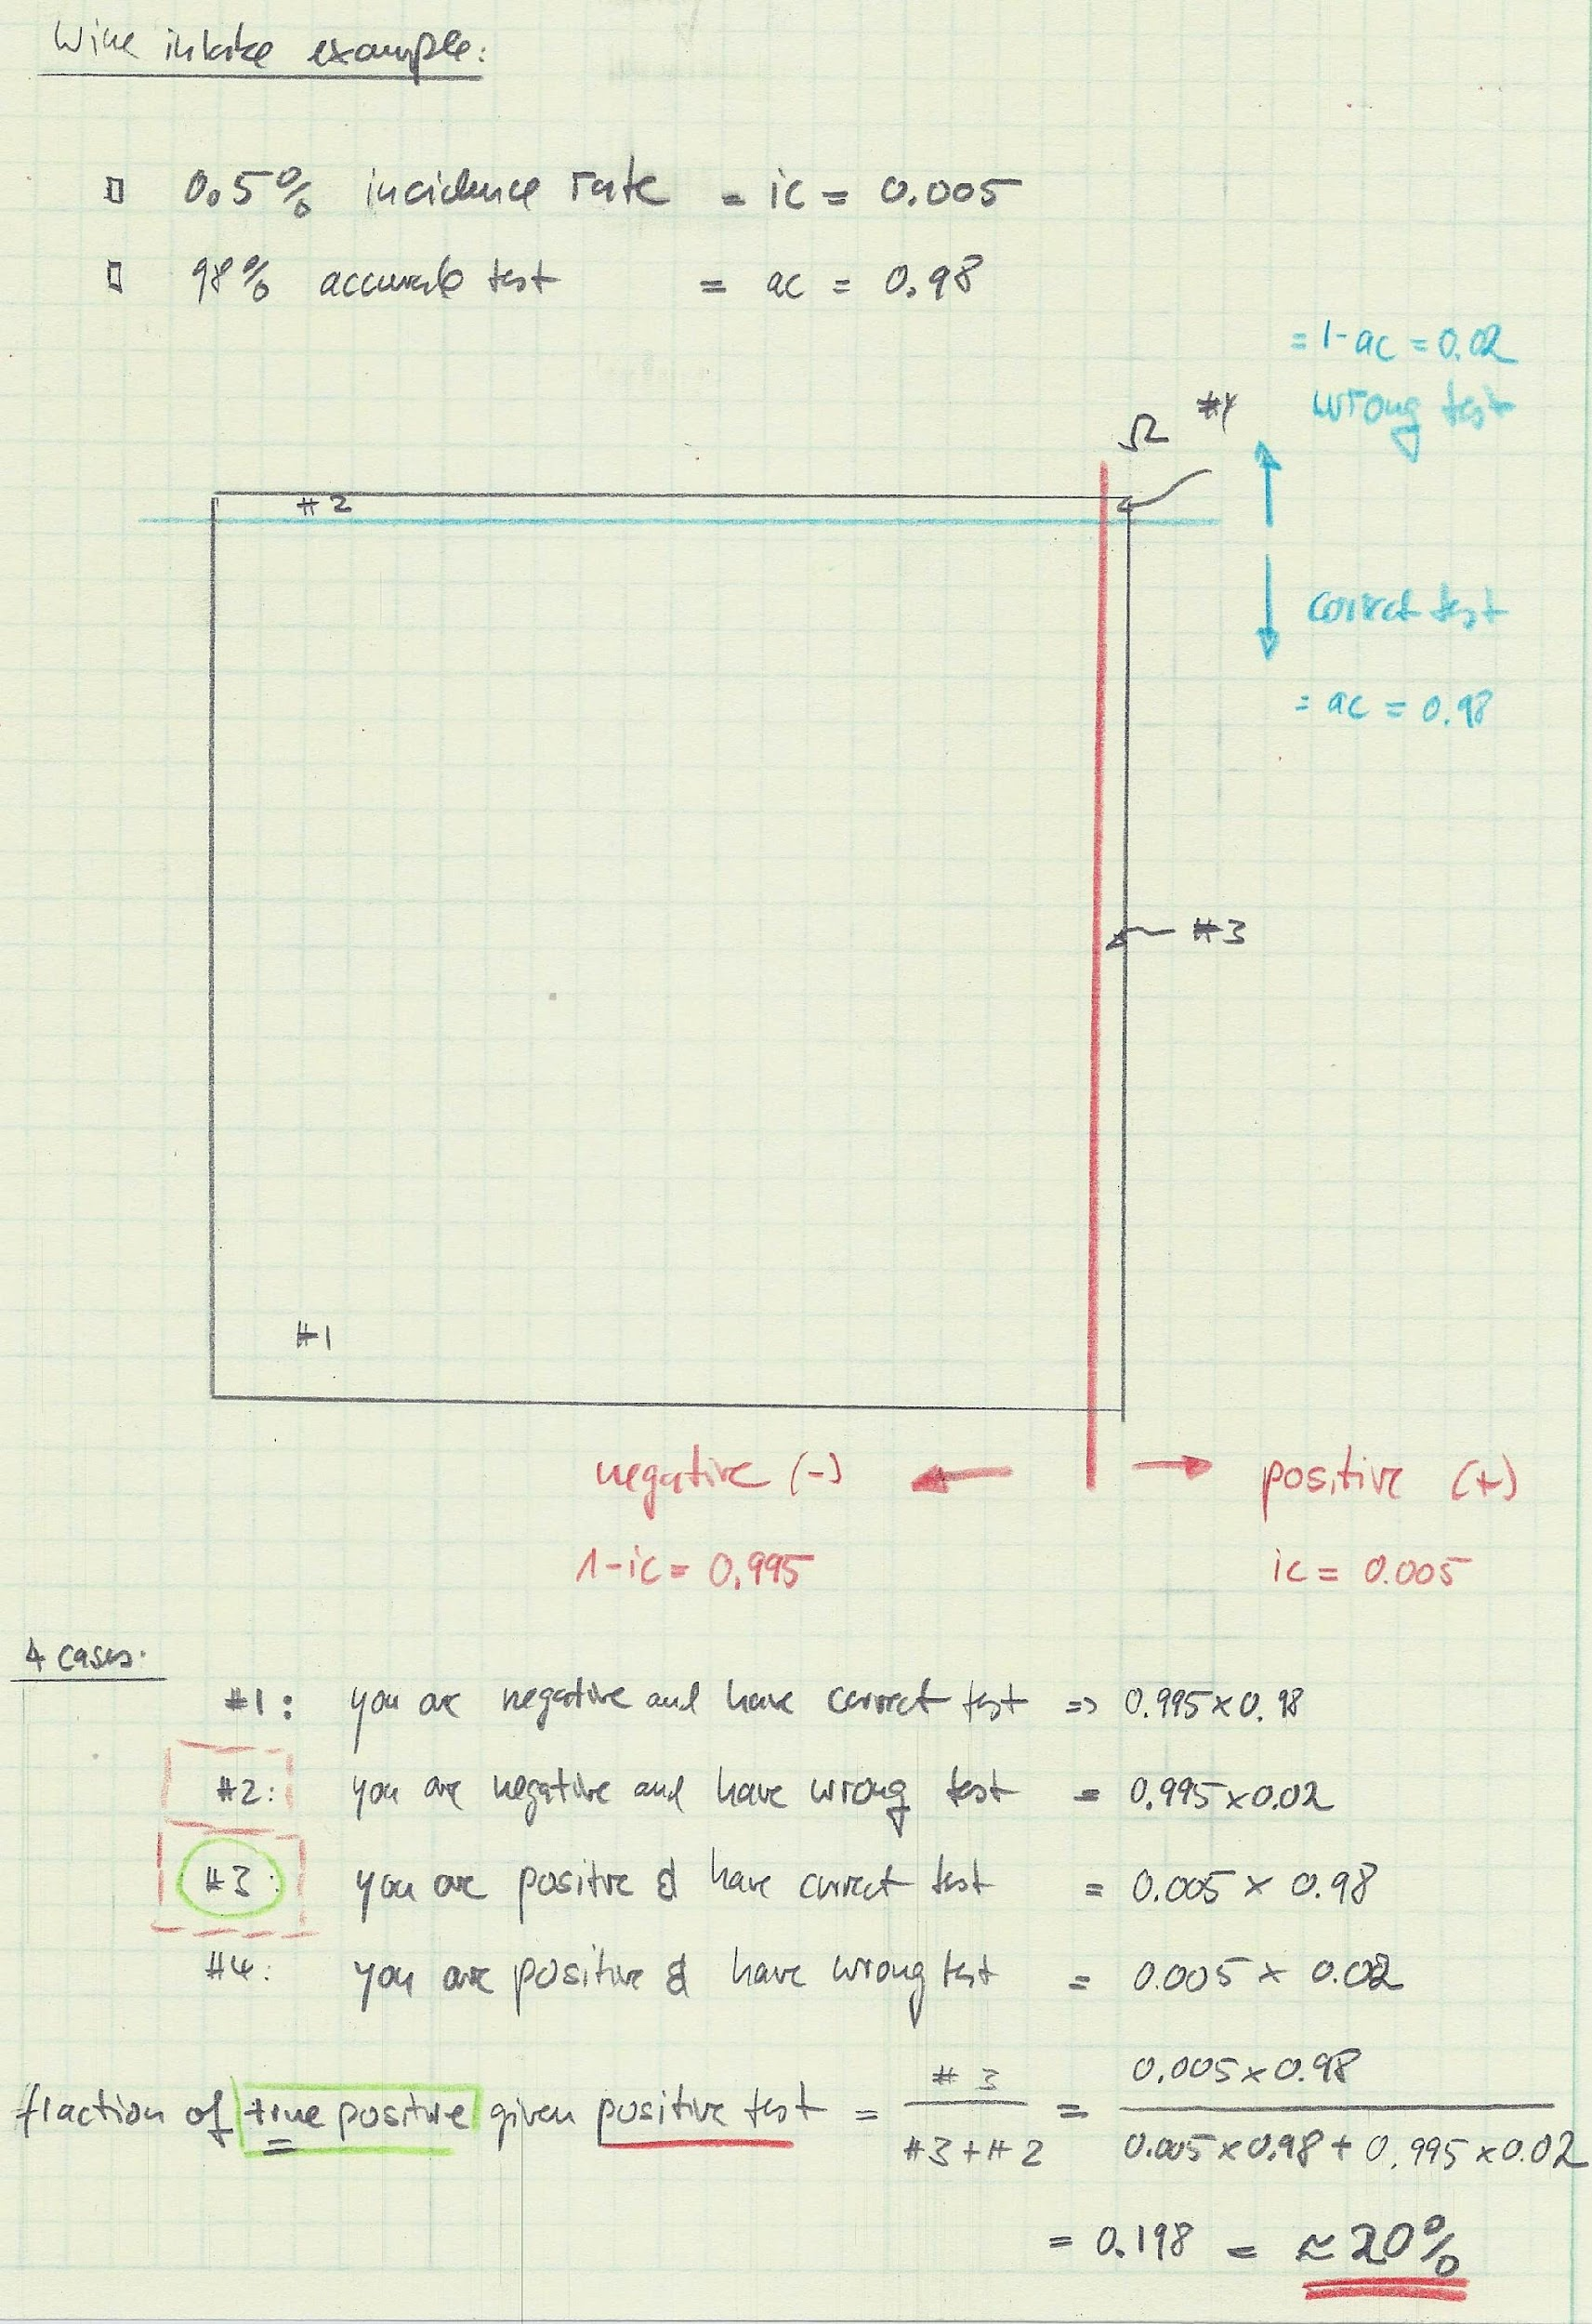
Solving the yodeling problem in a slow and intuitive way
(not Bayesian yet)

Slide 8
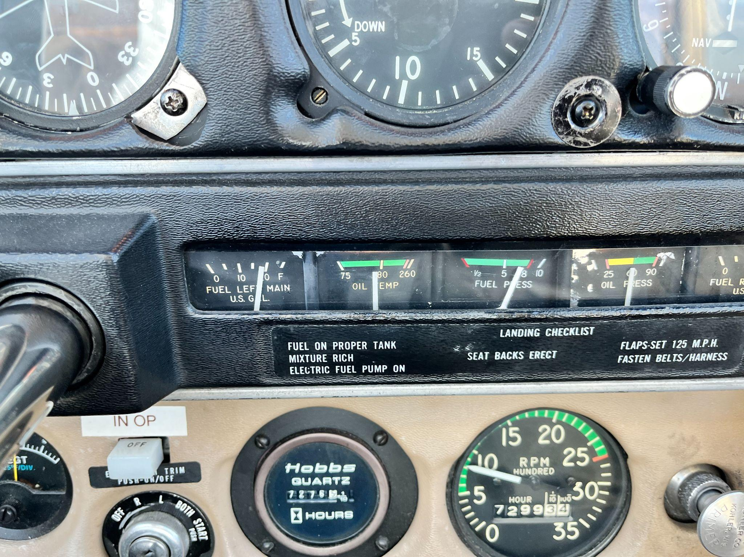
More applied: Can you still make it to the next airport three flight hours away?
Picture: Klaus Keller

Slide 9
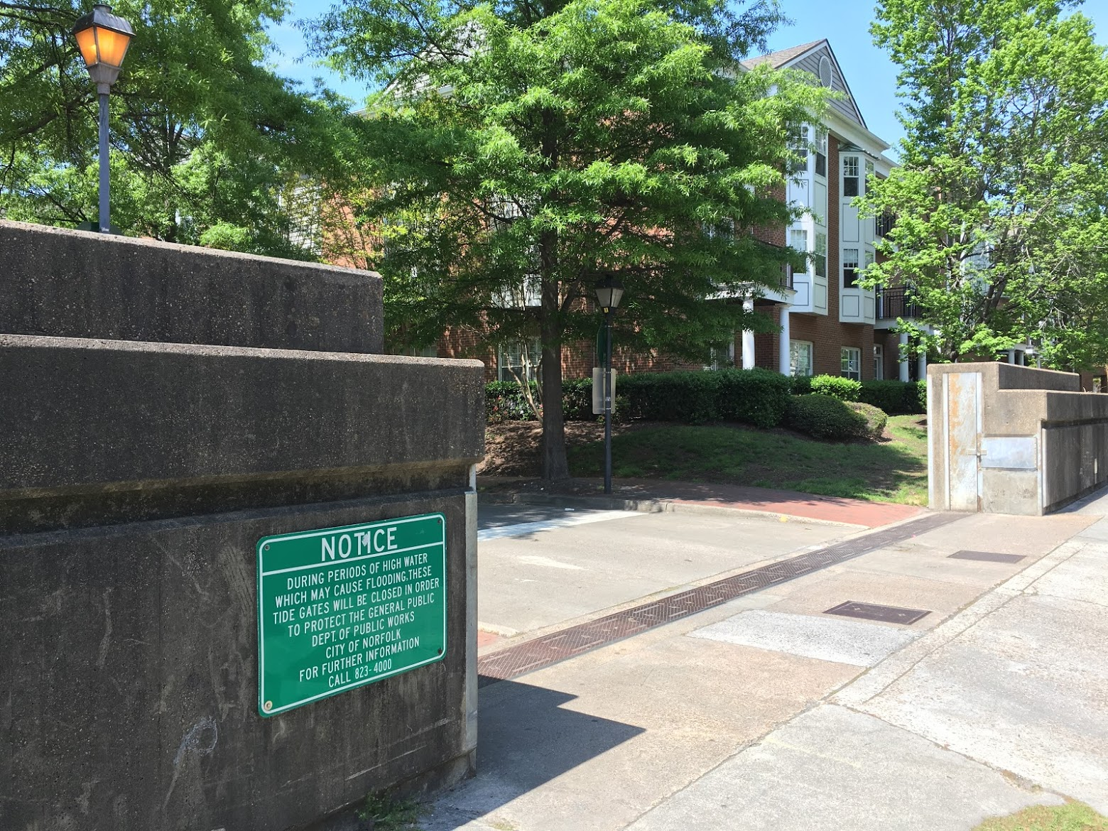
How high to build a new flood wall?
Picture: Klaus Keller,
(Floodwall in Norfolk, Virginia)

Slide 10
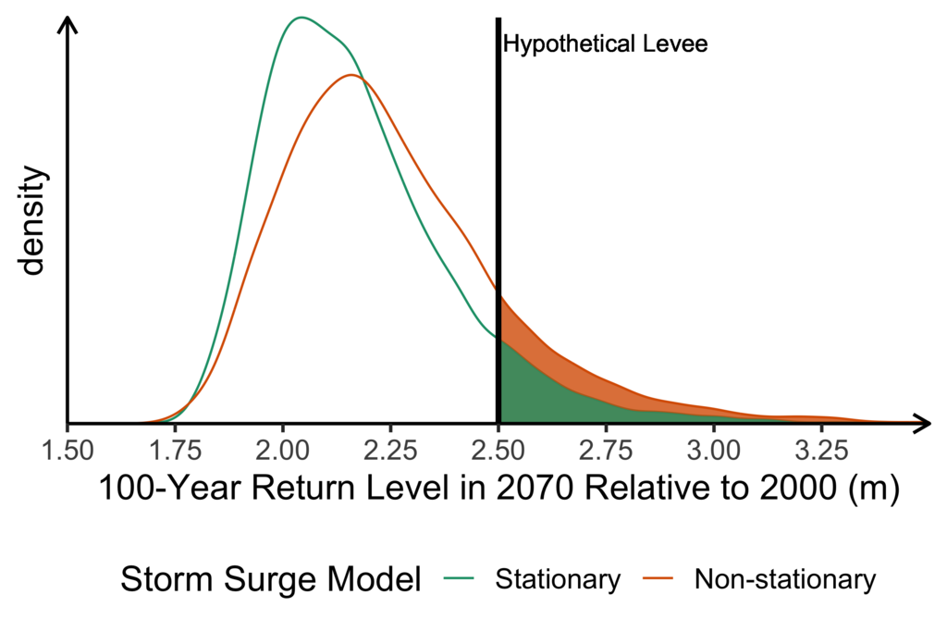
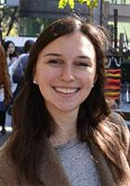
What is the flooding risk behind a levee?
What determines this risk?
What aspects of these questions are in the field of engineering?
upper tails drive
much of this flood risks
Wong, T. E., Klufas A., Srikrishnan, V., & Keller, K. (2018). Neglecting model structural uncertainty underestimates upper tails of flood hazard. Environmental Research Letters 13(7), 074019 (Results redrawn, simplified, and annotated for clarity)

Slide 11
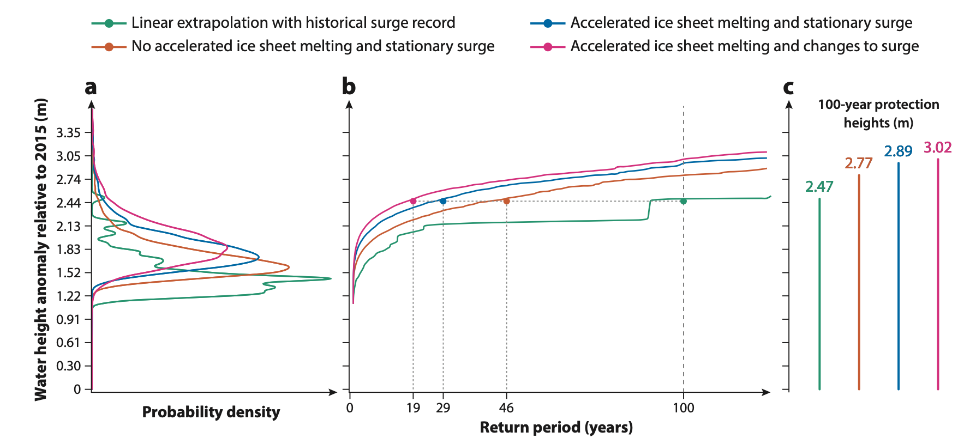
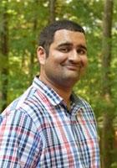
It turns out there may be several answers to parts of the question.
How to analyze and communicate these results?
Vivek Srikrishnan, R. Alley, and K. Keller: Investing in Science and Using the Results to Improve Climate Risk Management. EOS (2019) (redrawn for clarity).

Slide 12
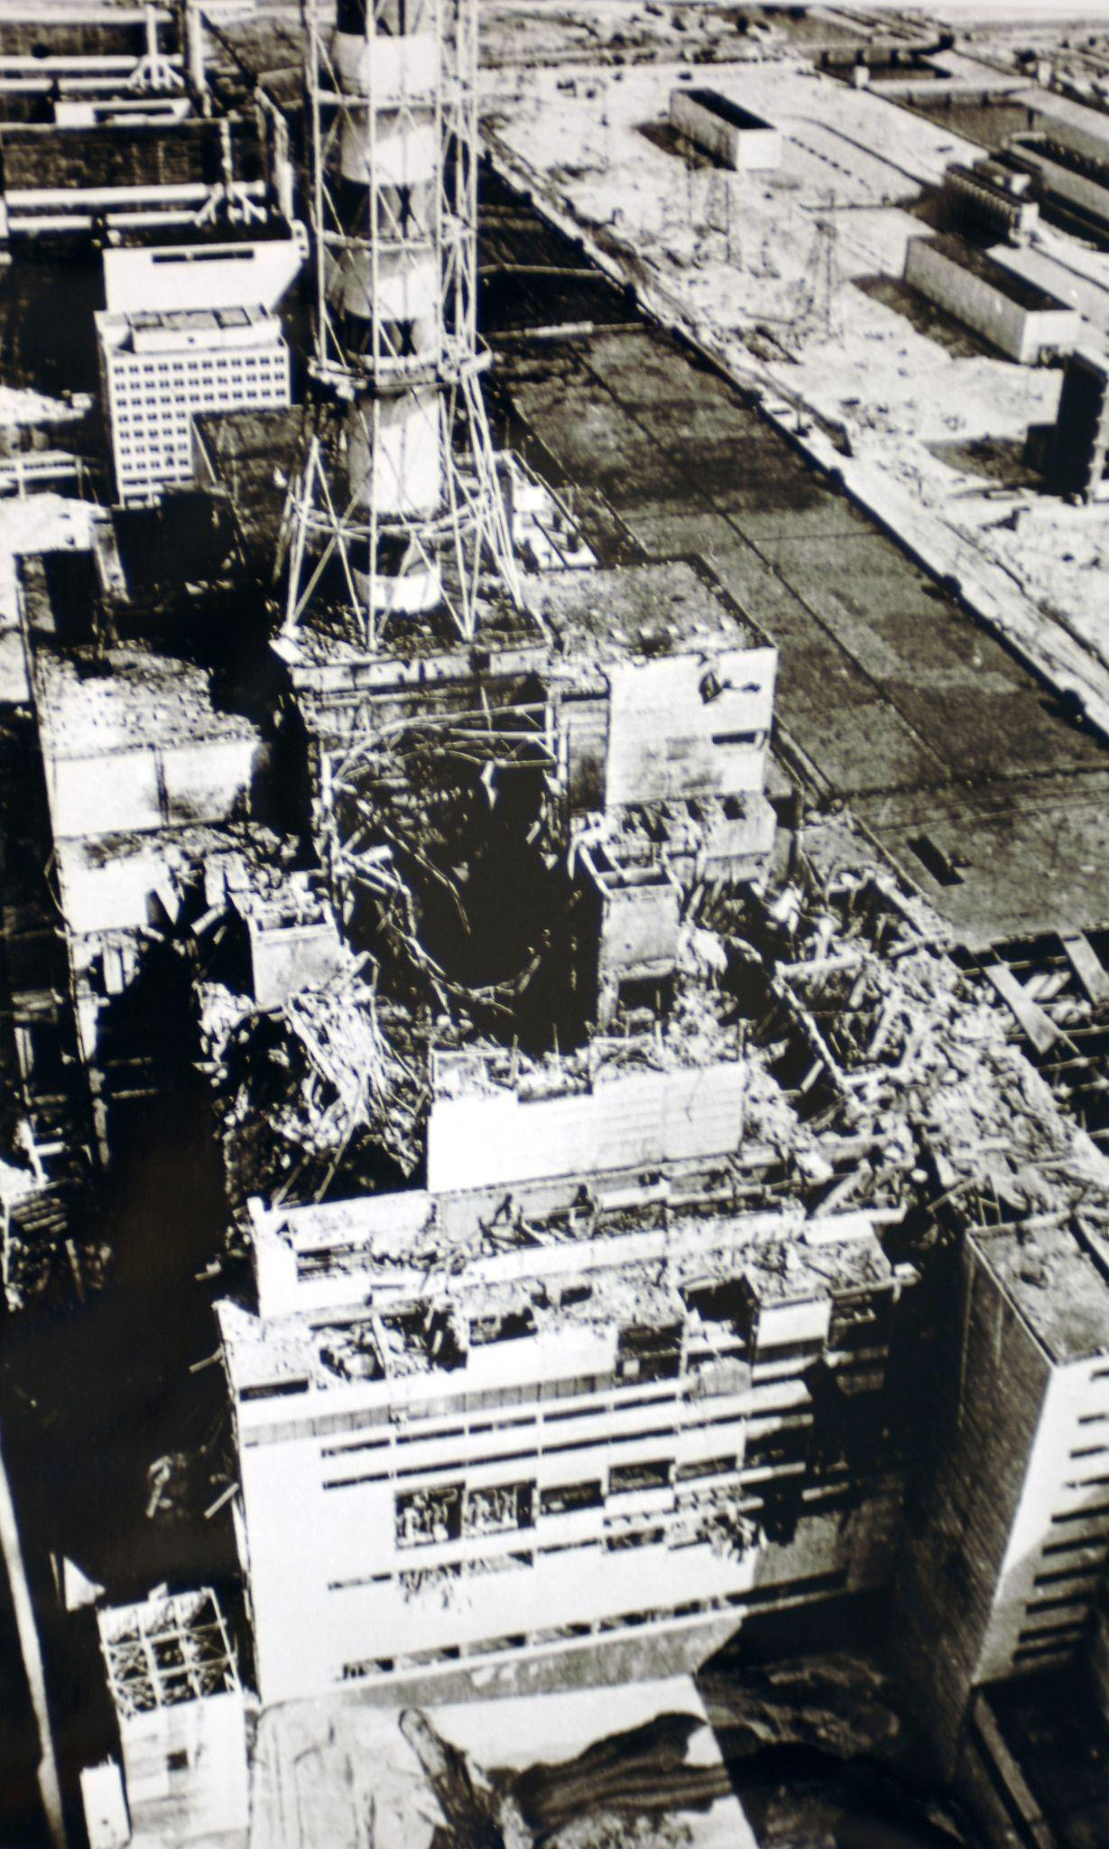
How probable is a nuclear accident?
See: Keller, W., & Modarres, M. (2005). A historical overview of probabilistic risk assessment development and its use in the nuclear power industry: a tribute to the late Professor Norman Carl Rasmussen. Reliability Engineering & System Safety, 89(3), 271–285. https://doi.org/10.1016/j.ress.2004.08.022
Picture By IAEA Imagebank - 02790015, CC BY-SA 2.0, https://commons.wikimedia.org/w/index.php?curid=63251598

Slide 13
Motivation
Statistical inferences in Engineering (and beyond) can be crucial and complex.
The number of observations can be small.
The predictions can hinge critically on deeply uncertain structural or prior assumptions.
The observation and model errors are unknown and not normally distributed.
The models can be nonlinear.
The observations may not stem from randomized and controlled experiments.
There are several possible models to analyze the observations.
Information gathered at one scale (e.g., several local observations) has to be used in the analysis at a different scale (e.g., a watershed, an entire plant, ..).
How one communicates the results affects outcomes.
Poor skills and techniques can have social, economic, ethical, and legal consequences.
Techniques taught in standard statistics can be of limited utility to address these issues.
Yet, despite these problems, decisions have to be made
How can we understand and solve (some) of these problems?

Slide 14
Course Objectives
Students will be able to understand, explain, choose, implement, and communicate concepts and techniques of Bayesian analyses relevant to their own research.

Slide 15
Disclaimer
This class will NOT educate to be a card-carrying and Ph.D.-level Bayesian statistician or to be able to perform complex and publication ready Bayesian analysis alone.
You will (hopefully) learn a few important skills.
Understand the vocabulary and basic tools.
Recognize when simple methods are appropriate (and when not).
Know about, how to implement, and how to apply more advanced and more appropriate methods.
Know where to get help if you stump onto a problem that requires more research.

Slide 16
Outline for today
Motivation
Getting to know each other
Overview of the course
Logistics

Slide 17
Getting to know each other
Please introduce yourself addressing at least the following questions:
Why are you in this class?
What kind of problems do you typically address in your studies / research (if any)?
What kind of statistical inferences do you think you will perform in the future or need to understand?
What is your previous training in statistics and programming?
If there is one outcome you would like to take away from this class, what would this be?
What is your favorite movie (and why)?

Slide 18
Outline for today
Motivation
Getting to know each other
Overview of the course
Logistics

Slide 19
Draft Schedule
Week | Week starting | Class 1 | Class 2 | Class 3 | Notes | Assignment out | Assignment due
1 | January 2, 2023 | No Class | Introduction to the class | Bayesian Approach I |  |  | none
2 | January 9, 2023 | Bayesian Approach II | Designing a project | Setting up Computation |  | 1 | none
3 | January 16, 2023 | No class (MLK day) | Analytical Solutions / Intuition | Bayesian Workflow Intro |  | 2 | 1
4 | January 23, 2023 | Precalibration /(Bayes) MC | MCMC Part 1 | MCMC Part 2 | discuss student ideas | 3 | 2
5 | January 30, 2023 | Students pitch project ideas | Writing a method section | Catching up / review |  | 4 | 3
6 | February 6, 2023 | Convergence diagnostics | Checking Assumptions | Deep Uncertainty |  | 5 | 4
7 | February 13, 2023 | Getting Solid Priors | Links to Decision-Making | Links to Decision-Making |  | 6 | 5
8 | February 20, 2023 | Model Choice | Emulation | Sensitivity analysis |  | 7 | 6
9 | February 27, 2023 | Communication of results | Student Presentations | Student Presentations |  | 8 | 7
10 | March 6, 2023 | Class Debriefing / Resarch links | No Class | No Class |  | none | 8

Slide 20
Outline for today
Motivation
Getting to know each other
Overview of the course
Logistics

Slide 21
Logistics
Weekly meetings:
Lectures: Classes: MWF 11:30 – 12:35 (009 ESCS)
X times on Tu 12:15 – 1:05 PM (on demand, announced)
Problem sets discussions: Fridays 14:00-15:00 (meet in my office and outside my office in a work area)
Office hours: Fridays 15:00-16:30 (in my office IR 385)
A mixture of
lectures to introduce the example problem, the theoretical background, and the possible approaches to solving the problem and
problem centered sessions where we tackle example problems in class exercises and code discussions.
Does everybody have access to a computer?
What are your experiences with data analysis programs?
Materials and assignments via CANVAS

Slide 22
Getting in touch and giving feedback
Office hours, by appointment, or just drop by.
Email is, in general, the fastest and easiest way to get in touch with me. Canvas messaging does not work fast with me.
This class is designed to be tuned to students research needs.
I suggest we play this adaptively.
Please:
Give me feedback on topics, style, speed, workload.
Suggest topics that are interesting to you

Slide 23
Expectations from Students
This class will require your sustained attention.
Students are expected to:
prepare for the meetings (e.g., by carefully reading and synthesizing the reading assignments and being prepared to present their synthesis in class),
actively contribute to the group discussions, and
prepare and submit the assignments in time.
The class is designed with the expectation that students spend roughly three times the lecture contact hours outside the class for readings and assignments.

Slide 24
Academic Integrity
We are all expected to do our own work on exams.
Plagiarism is the handing in of materials from other sources as your own work without quoting or clear citation.
Please review the syllabus on CANVAS and return a signed copy on the assigned due date.

Slide 25
Grading
The overall course grade will be based on a weighted average of the grades for these components:
Problem sets 40%
Term Project Presentation 20%
Written Term Project Report 40%
We adopt the Vikrant Vaze Grading Algorithm (1):
“Your final grade will be decided based on your absolute as well as relative performance in the class, whichever is higher. Out of 100 total points, if you score at least min(90, Median + Standard Deviation) points, you are guaranteed an HP grade. If you score at least min(75, Median - Standard Deviation) points, you are guaranteed at least a P grade. Note that this is even more favorable to you than the standard grading on the curve.”
Personal communication from Vikrant Vaze

Slide 26
Reading Assignments for Next Class
Core:
Applegate, P. J., & Keller, K. (Eds.). (2016). Risk analysis in the Earth Sciences: A Lab manual. 2nd edition. Leanpub. Open Source and free at: https://leanpub.com/raes (Chapter 1)
Clyde, M., M. Çetinkaya-Rundel, C. Rundel, D. Banks, C. Chai, L. Huang. (2022). An Introduction to Bayesian Thinking. Retrieved from https://statswithr.github.io/book/ accessed 02/07/2022 (Chapter 1)
Supplementary (if you are interested in background)
Freedman, D. (1997). Some Issues in the Foundation of Statistics. In B. C. van Fraassen (Ed.), Topics in the Foundation of Statistics (pp. 19–39). Springer Netherlands. https://doi.org/10.1007/978-94-015-8816-4_4
Jefferys, W. H., & Berger, J. O. (1992). Ockham’s razor and Bayesian analysis. American Scientist, 80(1), 64–72. https://www.jstor.org/stable/pdf/29774559.pdf
Clark, J. S. (2004). Why environmental scientists are becoming Bayesians: Modelling with Bayes. Ecology Letters, 8(1), 2–14. https://doi.org/10.1111/j.1461-0248.2004.00702.x

Slide 27
Review
Do you know
Who is in this course?
How this course is designed?
What you can learn in this course?
What is expected from you in this course?

Slide 28
Reserve Materials

Slide 29
What is your favorite movie?
The Seventh Seal
Casablanca
The Muppets Movie
Run Lola Run

Slide 30
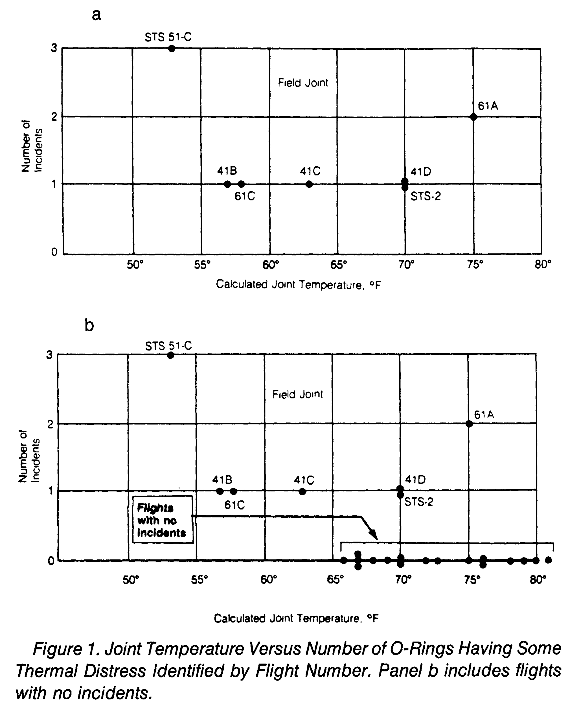
Is a launch of a space shuttle in cold temperatures a “go” or “no go”?
(Dalal et al, 1989)

Slide 31
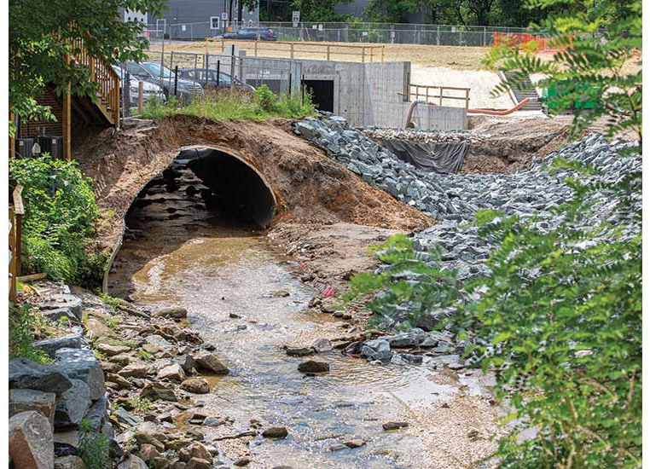
What size of stormwater pipe to choose?
https://www.enr.com/articles/47168-ellicott-city-md-advances-projects-and-refines-plans-to-fight-future-floods, accessed Feb 7 (2021). Picture by Pam Hunter McFarland

Slide 32
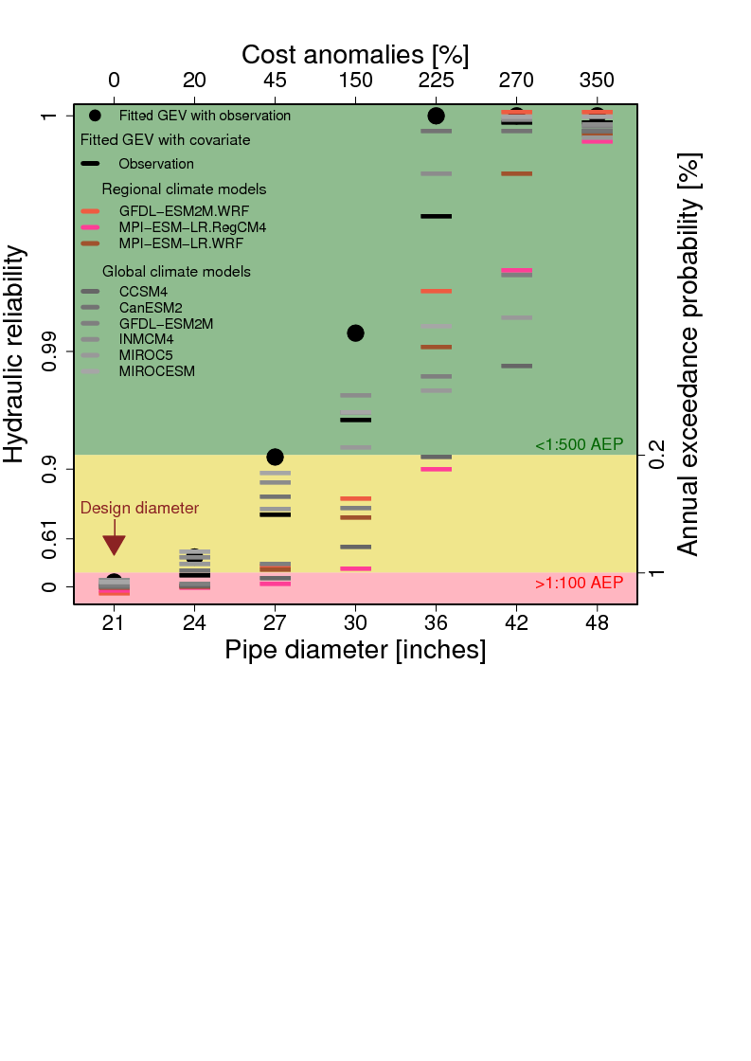
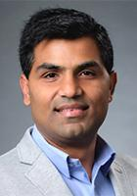
How big a pipe to choose?
Sharma, S., Lee, B. S., Nicholas, R. E., & Keller, K. (2021). Neglecting uncertainty can lead to failing stormwater infrastructures. https://arxiv.org/abs/2102.04496
Factor of 1.4

Slide 33
ENGG 107: Bayesian Statistical Modeling and Computation
The Bayesian Approach (I)
Meeting #2
Objectives for today:
Review of key concepts of probability
Introduction to the Bayesian Approach

Slide 34
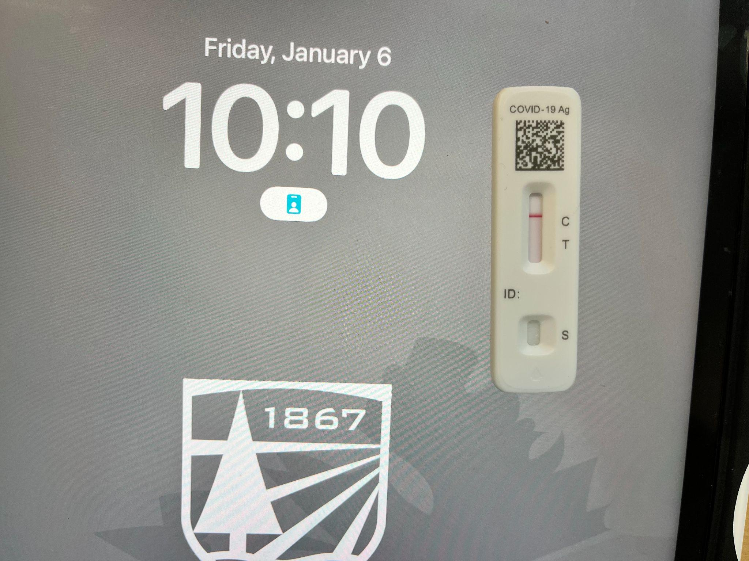
A note on COVID-19 and respiratory health

Slide 35
A note on COVID-19 and respiratory health
Please review and follow the Dartmouth COVID-19 policies.
https://covid.dartmouth.edu/
“Anyone accessing Dartmouth locations or Dartmouth in-person events must follow Dartmouth’s face-mask policy.”
“Regardless of vaccination status, if you are two years of age or older, you are required to wear a face mask:
If you are sick or have symptoms of COVID-19;
For at least 10 days after you first test positive for COVID-19, unless you are able to stop wearing a mask sooner by testing according to Dartmouth’s isolation guidance;
It remains a best practice to keep a face mask with you at all times as there will be situations outside of those mentioned above where masks continue to be required in the community.”
Please be considerate to others.
Wear a mask as advised and as it makes sense
Stay home if you are sick, we can work out class materials later.
If I know that I am COVID exposed / positive I will isolate and teach remotely.

Slide 36
Draft Schedule
Week | Week starting | Class 1 | Class 2 | Class 3 | Notes | Assignment out | Assignment due
1 | January 2, 2023 | No Class | Introduction to the class | Bayesian Approach I |  |  | none
2 | January 9, 2023 | Bayesian Approach II | Designing a project | Setting up Computation |  | 1 | none
3 | January 16, 2023 | No class (MLK day) | Analytical Solutions / Intuition | Bayesian Workflow Intro |  | 2 | 1
4 | January 23, 2023 | Precalibration /(Bayes) MC | MCMC Part 1 | MCMC Part 2 | discuss student ideas | 3 | 2
5 | January 30, 2023 | Students pitch project ideas | Writing a method section | Catching up / review |  | 4 | 3
6 | February 6, 2023 | Convergence diagnostics | Checking Assumptions | Deep Uncertainty |  | 5 | 4
7 | February 13, 2023 | Getting Solid Priors | Links to Decision-Making | Links to Decision-Making |  | 6 | 5
8 | February 20, 2023 | Model Choice | Emulation | Sensitivity analysis |  | 7 | 6
9 | February 27, 2023 | Communication of results | Student Presentations | Student Presentations |  | 8 | 7
10 | March 6, 2023 | Class Debriefing / Resarch links | No Class | No Class |  | none | 8

Slide 37
Recap from last time

Slide 38
What is yodeling?
https://www.youtube.com/watch?v=ByHPs5BQAqQ

Slide 39
The German Yodeling Test
There is genetic trait (i.e., exposure to German yodeling without headache) with a 0.5 % incidence rate in certain populations (let’s assume Germans). You, as a member of the population, test positive, but the test is only 98 % accurate (random error)
What is the probability that you have the trait after one, two, and three test applications with a positive test result?
Please try to solve this warm-up problem for the first yodeling test application.

Slide 40
Any volunteers to do this on the whiteboard?

Slide 41
Solving the yodeling problem in a quick, approximate and intuitive way (Frequentist)
0.5% incidence rate.
If the sample is a precise representation of the population, a sample of 200 people has 1 positive person.
Applying the test to 200 people provides approximately five positive tests results (one correct and four wrong positive).
The fraction of true positive to all positive results is ⅕=20%.
Credits: Discussion Prabhat and Klaus

Slide 42
Fixing the approximation:
Solving the yodeling problem in more slow, more precise, but still intuitive way
(Frequentist)

Slide 43
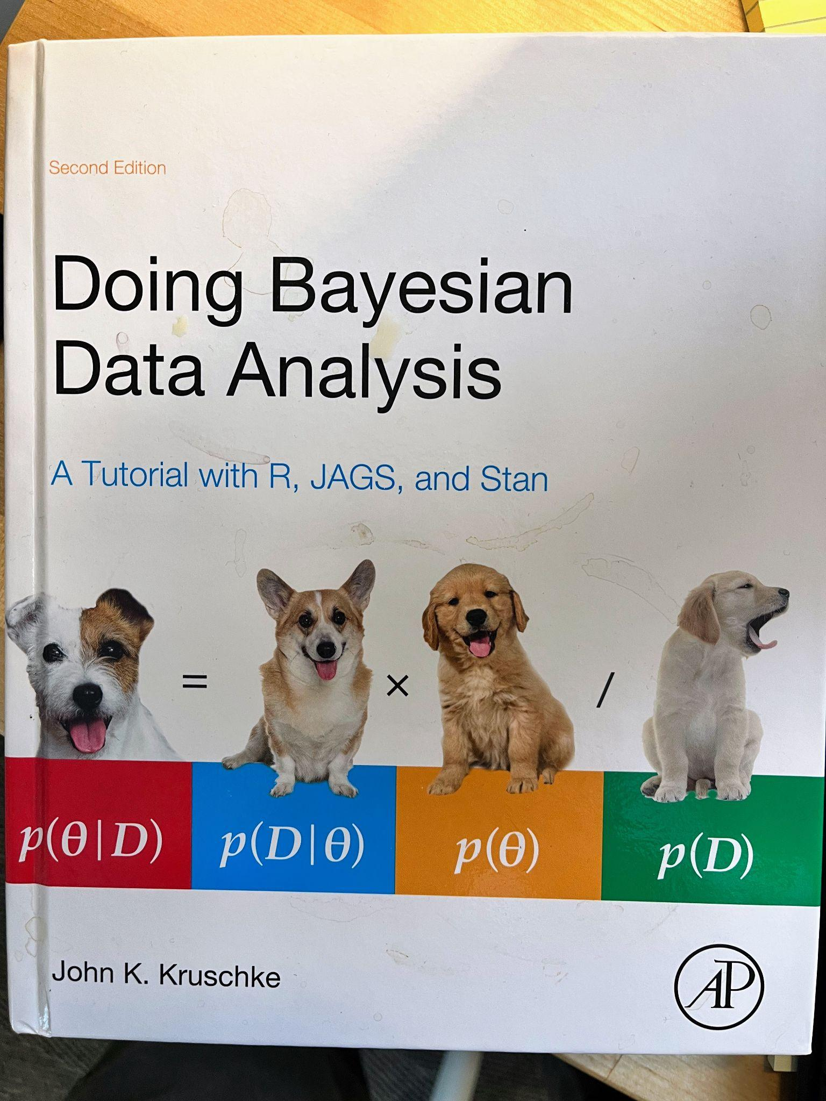
Puppies to the rescue…

Slide 44
Solving the yodeling problem in Bayesian way
P(A|B) = P(B|A) * P(A) / P(B) = 98% * 0.5% / (98% * 0.5% + 2% * 99.5%) ≈ 0.5% / (0.5% + 2%) = 0.5 / (0.5 + 2) = 20%
A: Have the trait
B: Tested positive in one test
After one test, the probability of having the trait would be 20%. Similarly, after two tests,
P(A|B) = P(B|A) * P(A) / P(B) = 98% * 98% * 0.5% / (98% * 98% * 0.5% + 2% * 2% * 99.5%) ≈ 92.346%
A: Have the trait
B: Tested positive in two tests
After two tests, the probability of having the trait would be 92.346%. After three tests,
P(A|B) = P(B|A) * P(A) / P(B) = 98% * 98% *98% * 0.5% / (98% * 98% *98% * 0.5% + 2% * 2% * 2% * 99.5%) ≈ 99.831%
A: Have the trait
B: Tested positive in three tests
After three tests, the probability of having the trait would be 99.831%
Credits: Email from your fellow student ang.xiao.th@dartmouth.edu on Jan 5 2023

Slide 45
Logistics
Weekly meetings:
Lectures: Classes: MWF 11:30 – 12:35 (009 ESCS)
X times on Tu 12:15 – 1:05 PM (on demand, announced)
Problem sets discussions: Fridays 14:00-15:00 (meet in my office and outside my office in a work area)
Office hours: Fridays 15:00-17:00 (in my office IR 385)
A mixture of
lectures to introduce the example problem, the theoretical background, and the possible approaches to solving the problem and
problem centered sessions where we tackle example problems in class exercises and code discussions.
Does everybody have access to a computer?
What are your experiences with data analysis programs?
Materials and assignments via CANVAS

Slide 46
Getting in touch and giving feedback
Office hours, by appointment, or just drop by.
Email is, in general, the fastest and easiest way to get in touch with me. Canvas messaging does not work fast with me.
This class is designed to be tuned to students research needs.
I suggest we play this adaptively.
Please:
Give me feedback on topics, style, speed, workload.
Suggest topics that are interesting to you

Slide 47
Expectations from Students
This class will require your sustained attention.
Students are expected to:
prepare for the meetings (e.g., by carefully reading and synthesizing the reading assignments and being prepared to present their synthesis in class),
actively contribute to the group discussions, and
prepare and submit the assignments in time.
The class is designed with the expectation that students spend roughly three times the lecture contact hours outside the class for readings and assignments.

Slide 48
Academic Integrity
We are all expected to do our own work on exams.
Plagiarism is the handing in of materials from other sources as your own work without quoting or clear citation.
Please review the syllabus on CANVAS and return a signed copy on the assigned due date.

Slide 49
Grading
The overall course grade will be based on a weighted average of the grades for these components:
Problem sets 40%
Term Project Presentation 20%
Written Term Project Report 40%
We adopt the Vikrant Vaze Grading Algorithm (1):
“Your final grade will be decided based on your absolute as well as relative performance in the class, whichever is higher. Out of 100 total points, if you score at least min(90, Median + Standard Deviation) points, you are guaranteed an HP grade. If you score at least min(75, Median - Standard Deviation) points, you are guaranteed at least a P grade. Note that this is even more favorable to you than the standard grading on the curve.”
Personal communication from Vikrant Vaze

Slide 50
Review
Do you know
Who is in this course?
How this course is designed?
What you can learn in this course?
What is expected from you in this course?
How to solve the German Yodeling Test problem?

Slide 51
End Recap from last time

Slide 52
Outline for today
Reading reviews
More on motivation
Key concepts of probability
Conditional probability
Bayesian vs Frequentist interpretation of probability
The prior, the likelihood, and the posterior

Slide 53
Outline for today
Reading reviews
More on motivation
Key concepts of probability
Conditional probability
Bayesian vs Frequentists
The prior, the likelihood, the posterior

Slide 54
Review of Reading Assignments
Core:
Applegate, P. J., & Keller, K. (Eds.). (2016). Risk analysis in the Earth Sciences: A Lab manual. 2nd edition. Leanpub. Open Source and free at: https://leanpub.com/raes (please read the Chapter: "Introduction")
Clyde, M., M. Çetinkaya-Rundel, C. Rundel, D. Banks, C. Chai, L. Huang. (2022). An Introduction to Bayesian Thinking. Retrieved from https://statswithr.github.io/book/ accessed 02/07/2022 (Please read Chapter 1).
Supplementary (if you are interested in background)
Freedman, D. (1997). Some Issues in the Foundation of Statistics. In B. C. van Fraassen (Ed.), Topics in the Foundation of Statistics (pp. 19–39). Springer Netherlands. https://doi.org/10.1007/978-94-015-8816-4_4
Jefferys, W. H., & Berger, J. O. (1992). Ockham’s razor and Bayesian analysis. American Scientist, 80(1), 64–72. https://www.jstor.org/stable/pdf/29774559.pdf
Clark, J. S. (2004). Why environmental scientists are becoming Bayesians: Modelling with Bayes. Ecology Letters, 8(1), 2–14. https://doi.org/10.1111/j.1461-0248.2004.00702.x

Slide 55
Reading Review Questions
What are the main points?
What remains unclear?
What questions does this raise?
What does this mean for your research / project design?

Slide 56
Outline for today
Reading reviews
More on motivation
Key concepts of probability
Conditional probability
Bayesian vs Frequentists
The prior, the likelihood, the posterior

Slide 57
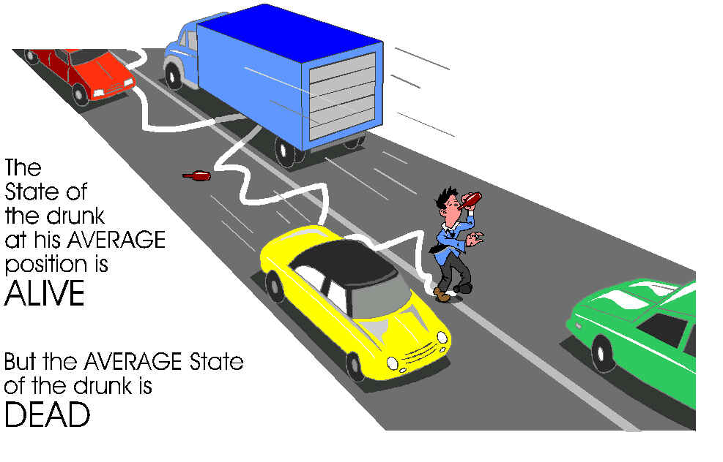
Why may an analysis that neglects uncertainty lead to poor decisions?
Uncertainty can be thy enemy.
Know thy enemy.
http://web.stanford.edu/~savage/flaw/

Slide 58
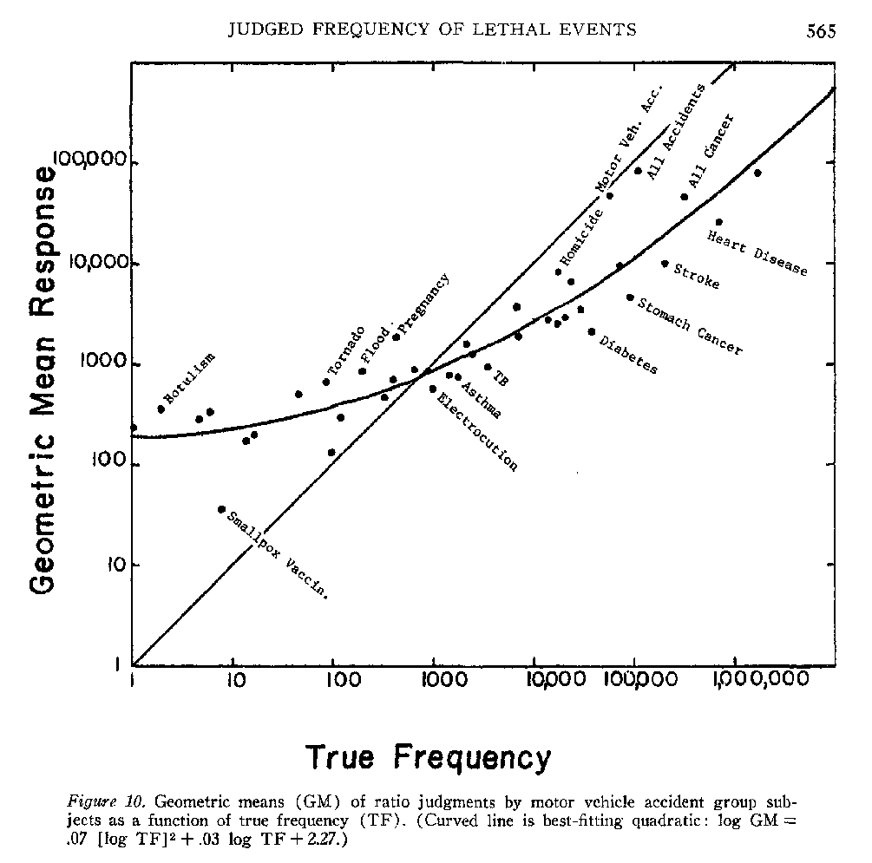
Why perform quantitative and formal risk analysis?
Lichtenstein 1978

Slide 59
Recap: Do you bet on a new coin?
Someone approaches you in Times Square in NYC.
They offer you a bet on a coin resting on their hand.
You see a head on the upwards side of the coin you can see.
Bet: Pay 10$ upfront. If there is just one tail in 10 repeated tosses of the coin, you get double your payment.
Do you accept this bet?
How would you analyze this decision using the statistics you have learned thus far?

Slide 60
Let’s get started very simple: a possibly crooked coin…
Is this coin fair?
Typical interpretation: “Fair” means that the probabilities of “heads” and “tails” are equal.
Questions:
What is probability?
How can we estimate a probability?
How can we decide this question?
How certain are we about our answer?

Slide 61
Outline for today
Reading reviews
More on motivation
Key concepts of probability
Conditional probability
Bayesian vs Frequentists
The prior, the likelihood, the posterior

Slide 62
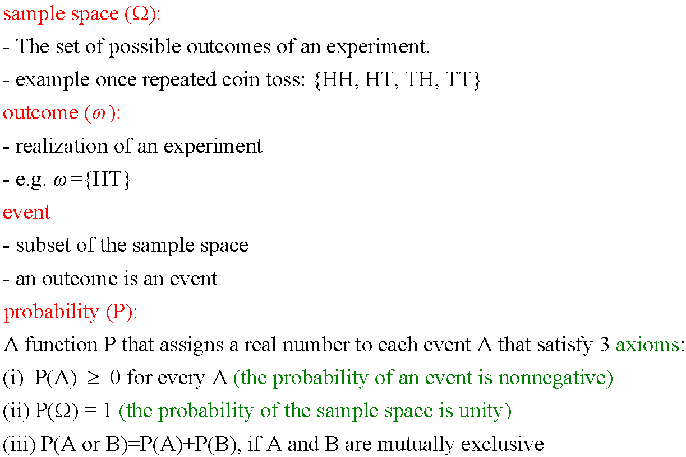
Summary of Terminology
Wasserman (2004) Wilks (1995)

Slide 63
Graphical Review of Terminology
Sample Space (Ω)
Event
A
Outcome (ω)
Event
B

Slide 64
Review of Probability
Ω
P(Ω) = ?

Slide 65
Review of Probability
Ω
P(Ω) = 1
A
P(A) = ?

Slide 66
Review of Probability
Ω
P(Ω) = 1
A |  |  | B
8
P(A) =
25
P(B) = ?

Slide 67
Review of Probability
Ω
P(Ω) = 1
A |  |  | B
8
P(A) =
25
6
P(B) =
25
P(A or B) = ?

Slide 68
Review of Probability
Ω
P(Ω) = 1
A |  |  | B
8
P(A) =
25
6
P(B) =
25
14
P(A or B) =
25

Slide 69
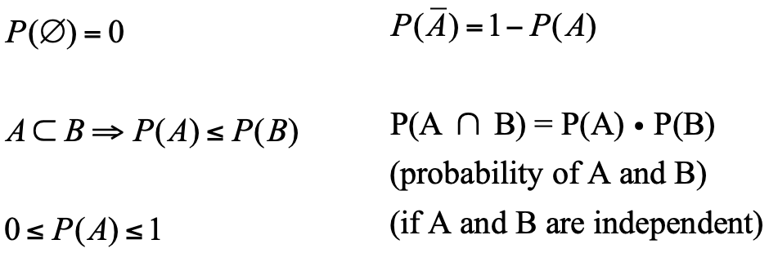
Basic Properties of Probabilities
Wasserman (2004)

Slide 70


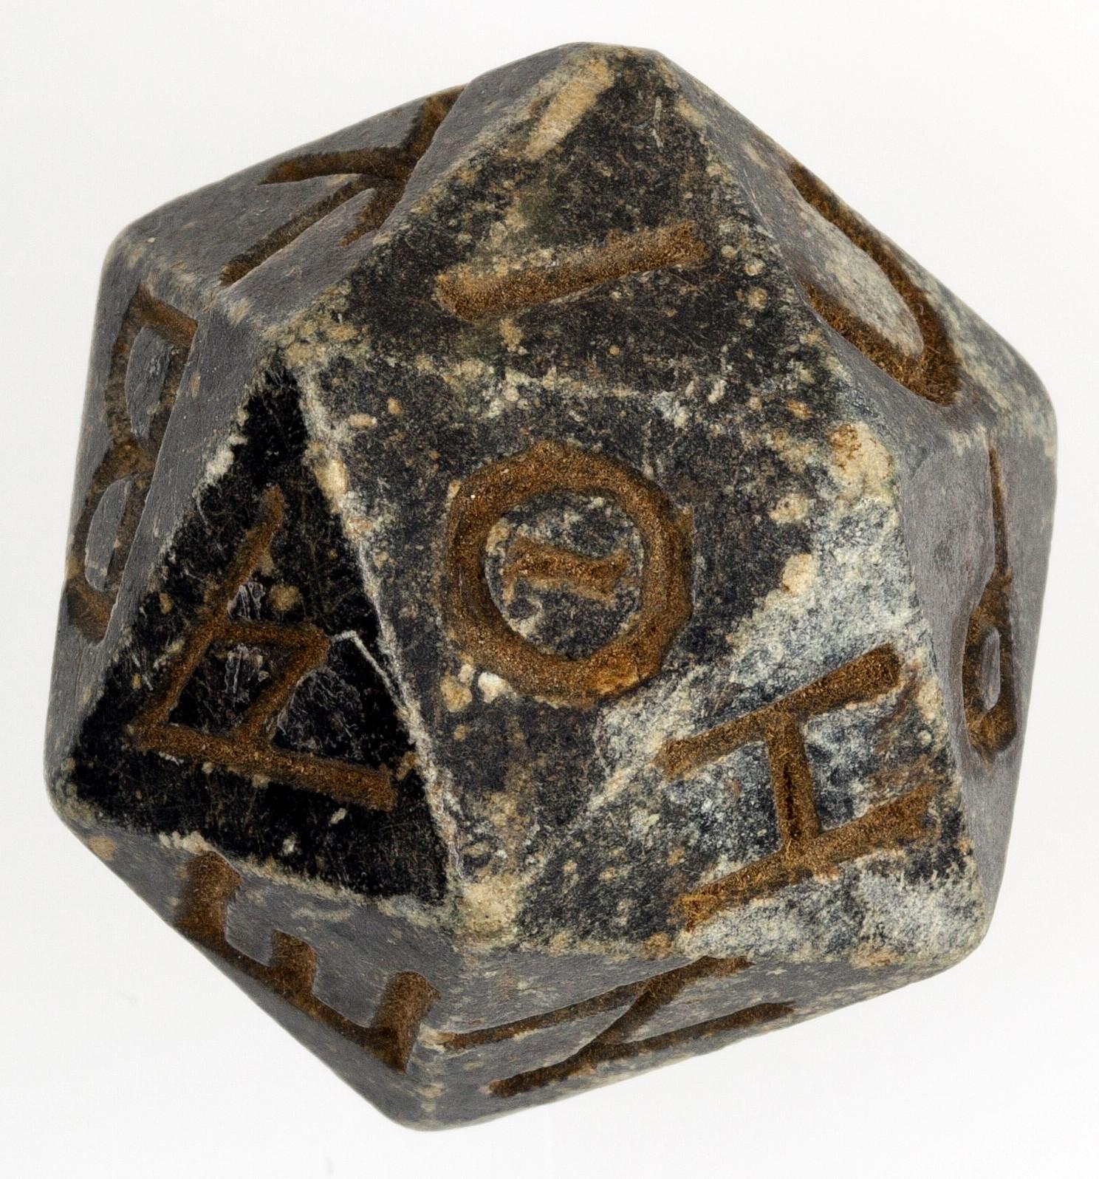
What is (deep) uncertainty for a dice outcome?
certain
uncertain
deeply uncertain
(We don’t know how many sides the die we’ll get has)
Credits: Sphere: Klaus Keller, Dice: https://en.wikipedia.org/wiki/Dice#/media/File:Twenty-sided_die_(icosahedron)_with_faces_inscribed_with_Greek_letters_MET_10.130.1158_001.jpg accessed Dec 28 2022 This file was donated to Wikimedia Commons as part of a project by the Metropolitan Museum of Art., Multiple Dice: By Diacritica - This file has been extracted from another file, CC BY-SA 3.0, https://commons.wikimedia.org/w/index.php?curid=88501597, accesses Dec 28 2022

Slide 71
Outline for today
Reading reviews
More motivating example problems
Key concepts of probability
Conditional probability
Bayesian vs Frequentists
The prior, the likelihood, the posterior

Slide 72
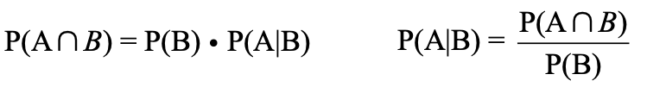
Conditional Probabilities
 | A
 |  | A and B |  |  | B
Notes:
P(A)=10/35
P((B)=12/35
P(A and B)=3/35
P(A given B)=3/12 (by count)
Check equations:
P(A and B) = P(B)*P(A given B) =12/35*

Slide 73
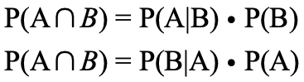
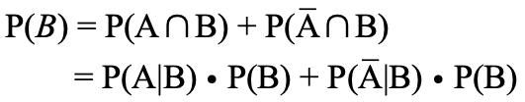
Law of Total Probabilities
 | A
 |  | A and B |  |  | B
 |  |  | not A and B
Multiplication rule:
Law of total
probability:

Slide 74
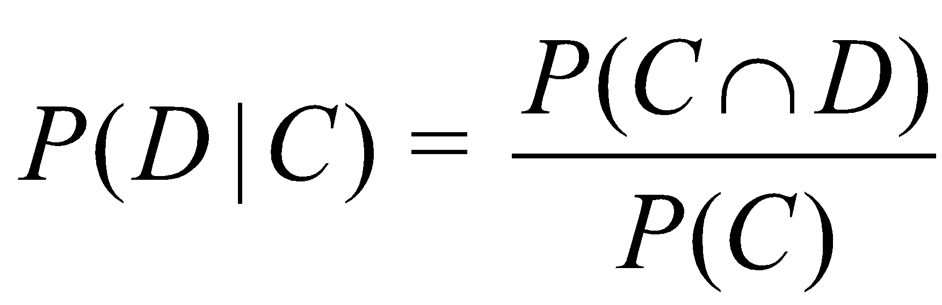
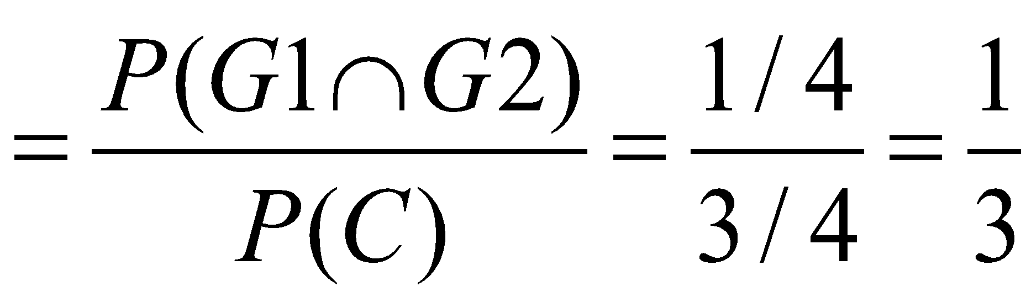
Example of Conditional Probability
Family, 2 children
What is the probability of having two girls, if the family has at least one girl?
D: Both are girls
C: At least one girl
First Child | Second Child | Number of Girls | Probability
 | G2 | 2 | 1/4
G1
 | B2 | 1 | 1/4
 | G2 | 1 | 1/4
B1
 | B2 | 0 | 1/4
ftp.stat.duke.edu/Users/db/DOE_in_Charleston.ppt

Slide 75
Outline for today
Reading reviews
More motivating example problems
Key concepts of probability
Conditional probability
Bayesian vs Frequentists
The prior, the likelihood, the posterior

Slide 76
Two interpretations of probability
P(H) is the frequency of the outcome H in the limit of an infinitely long experiment.
“Frequentist” approach
P(H) is the degree of belief of an observer that H will occur in the next experiment.
“Bayesian” approach.
Long and ongoing battle between Frequentists and Bayesians.
Wasserman (2004)

Slide 77
Outline for today
Reading reviews
More motivating example problems
Key concepts of probability
Conditional probability
Bayesian vs Frequentists
The prior, the likelihood, the posterior

Slide 78
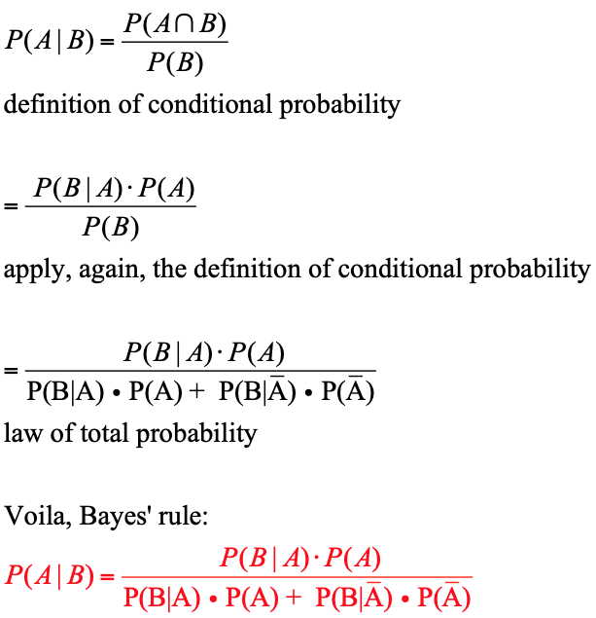
Derivation of Bayes’ Rule

Slide 79
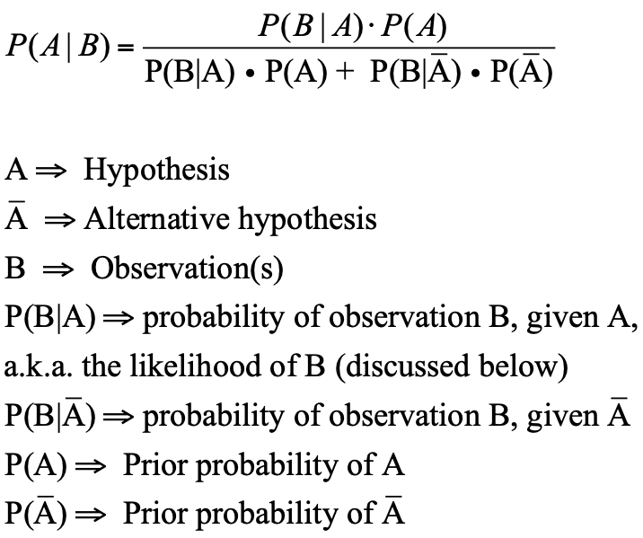
One application of Bayes’ rule

Slide 80
Zebras vs horses?
You stand in Times Square in NYC and hear the sound of hoofs behind you.
Without turning around, what is your estimate of the probability the this is a zebra or a horse behind you?
How do you arrive at this estimate?
Does your estimate change if you were
in the zoo in Central Park?
in a national park in the Serengeti?
at a horse race track?

Slide 81
Solving the zebra problem the Bayesian way
What are we looking for?
What is the prior?
What is the likelihood function?
What the the posterior?

Slide 82
Reading Assignments for Next Class
Core
van de Schoot, R., Depaoli, S., King, R., Kramer, B., Märtens, K., Tadesse, M. G., Vannucci, M., Gelman, A., Veen, D., Willemsen, J., & Yau, C. (2021). Bayesian statistics and modelling. Nature Reviews Methods Primers, 1(1), 1–26. https://doi.org/10.1038/s43586-020-00001-2 This is somewhat tough going. We will use this as a map and an example how people write a primer for the entire field.
Background (if you are interested)
Freedman, D. (1997). Some Issues in the Foundation of Statistics. In B. C. van Fraassen (Ed.), Topics in the Foundation of Statistics (pp. 19–39). Springer Netherlands. https://doi.org/10.1007/978-94-015-8816-4_4
Jefferys, W. H., & Berger, J. O. (1992). Ockham’s razor and Bayesian analysis. American Scientist, 80(1), 64–72. https://www.jstor.org/stable/pdf/29774559.pdf

Slide 83
Review
What is probability?
What is a Bayesian approach?
What is the Bayes equation and how can you derive it?
What are key differences between a Bayesian and a Frequentist approach?
How to define and use (in a simple example)
prior
likelihood
probability

Slide 84
Reserve Materials

Slide 85
ENGG 107: Bayesian Statistical Modeling and Computation
The Bayesian Approach (II) Meeting #3
Objectives for today:
Recap of the introduction to the Bayesian approach
Refining our understanding of the Bayesian approach

Slide 86
Draft Schedule
Week | Week starting | Class 1 | Class 2 | Class 3 | Notes | Assignment out | Assignment due
1 | January 2, 2023 | No Class | Introduction to the class | Bayesian Approach I |  |  | none
2 | January 9, 2023 | Bayesian Approach II | Designing a project | Setting up Computation |  | 1 | none
3 | January 16, 2023 | No class (MLK day) | Analytical Solutions / Intuition | Bayesian Workflow Intro |  | 2 | 1
4 | January 23, 2023 | Precalibration /(Bayes) MC | MCMC Part 1 | MCMC Part 2 | discuss student ideas | 3 | 2
5 | January 30, 2023 | Students pitch project ideas | Writing a method section | Catching up / review |  | 4 | 3
6 | February 6, 2023 | Convergence diagnostics | Checking Assumptions | Deep Uncertainty |  | 5 | 4
7 | February 13, 2023 | Getting Solid Priors | Links to Decision-Making | Links to Decision-Making |  | 6 | 5
8 | February 20, 2023 | Model Choice | Emulation | Sensitivity analysis |  | 7 | 6
9 | February 27, 2023 | Communication of results | Student Presentations | Student Presentations |  | 8 | 7
10 | March 6, 2023 | Class Debriefing / Resarch links | No Class | No Class |  | none | 8

Slide 87
Review
What is probability?
What is a Bayesian approach?
What is the Bayes equation and how can you derive it?
What are key differences between a Bayesian and a Frequentist approach?
How to define and use (in a simple example)
prior
likelihood
probability

Slide 88
Outline for today
Review of reading assignment
Why may we need a Bayesian approach?
How does a Bayesian approach work?
prior
likelihood
posterior
Bayesian updating
The pesky aspects of computation

Slide 89
Outline for today
Review of reading assignment
Why may we need a Bayesian approach?
How does a Bayesian approach work?
prior
likelihood
posterior
Bayesian updating
The pesky aspects of computation

Slide 90
Review of Reading Assignments
Core
van de Schoot, R., Depaoli, S., King, R., Kramer, B., Märtens, K., Tadesse, M. G., Vannucci, M., Gelman, A., Veen, D., Willemsen, J., & Yau, C. (2021). Bayesian statistics and modelling. Nature Reviews Methods Primers, 1(1), 1–26. https://doi.org/10.1038/s43586-020-00001-2
Background (if you are interested)
Freedman, D. (1997). Some Issues in the Foundation of Statistics. In B. C. van Fraassen (Ed.), Topics in the Foundation of Statistics (pp. 19–39). Springer Netherlands. https://doi.org/10.1007/978-94-015-8816-4_4
Jefferys, W. H., & Berger, J. O. (1992). Ockham’s razor and Bayesian analysis. American Scientist, 80(1), 64–72. https://www.jstor.org/stable/pdf/29774559.pdf

Slide 91
Reading Review Questions
What are the main points?
What remains unclear?
What questions does this raise?
What does this mean for your research / project design?

Slide 92
Outline for today
Review of reading assignment
Why may we need a Bayesian approach?
How does a Bayesian approach work?
prior
likelihood
posterior
Bayesian updating
The pesky aspects of computation

Slide 93
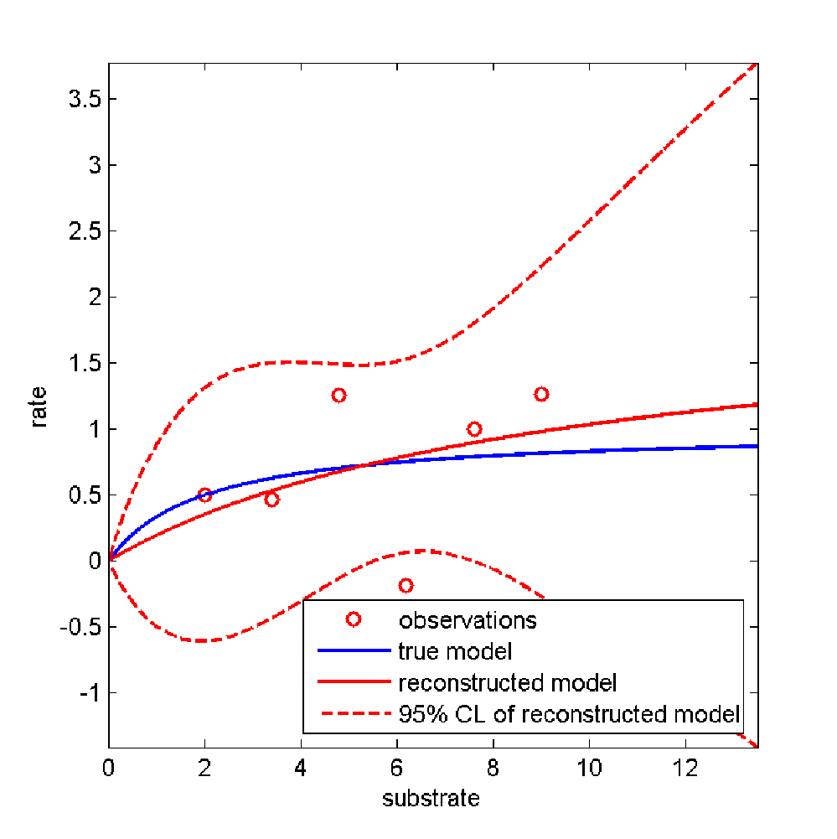
Challenge: We know that negative parameters and rates are nonsense.
How can we use this independent information?

Slide 94
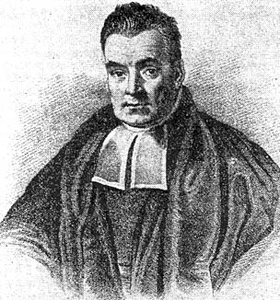
Motivation for Bayesian Analyses
You run an experiment and estimate decay rates. Some of the confidence limits for the decay rates derived from your frequentist software include negative values.
You run an experiment to estimate diffusion rates. Again, some confidence limits for the decay rates derived from your frequentist software include negative value
Your physical knowledge tells you that this is impossible.
How can you represent this physical knowledge in a statistically sound way?
Bayes to the rescue
“Thomas Bayes [..] c. 1701 – 7 April 1761 [..] was an English statistician, philosopher and Presbyterian minister who is known for formulating a specific case of the theorem that bears his name: Bayes' theorem.”
Credit: Picture: https://en.wikipedia.org/wiki/Thomas_Bayes#/media/File:Thomas_Bayes.gif, public domain, accessed Dec 28 2022, quote: https://en.wikipedia.org/wiki/Thomas_Bayes, accessed Dec 28 2022

Slide 95
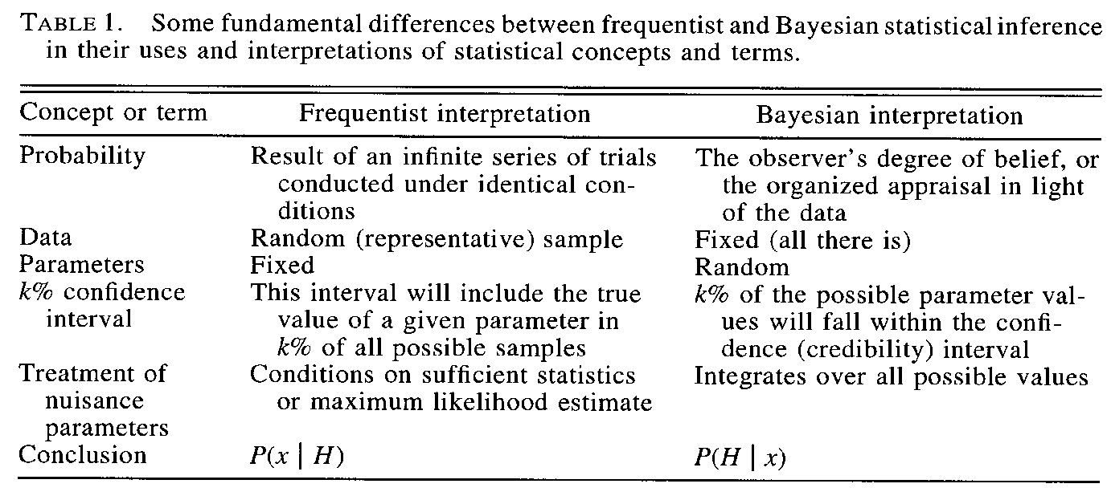
Frequentist vs. Bayesian Differences
Ellison, A. M. (1996). An introduction to Bayesian inference for ecological research and environmental decision-making. Ecological Applications: A Publication of the Ecological Society of America, 6(4), 1036–1046. https://doi.org/10.2307/2269588

Slide 96
Balancing Errors
“Howard Raiffa (1968, p. 264) noted that statistics students learn the importance of constantly balancing making an error of the first kind (that is, rejecting the null hypothesis when it is true) and an error of the second kind, that is, accepting the null hypothesis when it is false (Fig. 22.1). Raiffa thought it was John Tukey who suggested that practitioners all too often make errors of a third kind: of solving the wrong problem. Raiffa nominated a candidate for the error of the fourth kind: solving the right problem too late. John Tukey believed that it was better to find an approximate answer to the right question, than the exact answer to the wrong question, which can always be made precise.”
Quote from: Singer, D. A. (2018). Solving the Wrong Resource Assessment Problems Precisely. In Handbook of Mathematical Geosciences (pp. 437–446). Springer, Cham. Retrieved from https://library.oapen.org/bitstream/handle/20.500.12657/22939/1007222.pdf?sequence=1#page=446

Slide 97
Testing a hypothesis: Type 1 and Type 2 errors
Frequentist approach
Type 1 error:
Effect is noise but we assign significant connection.
Null-hypothesis is rejected, when it is actually true
“False positive”.
Steve Schneider claiming the ice ages are coming back in the 1970’s.
The probability of a Type 1 error is associated with the confidence level of correct statistical tests. For a 95% confidence, the probability of a Type 1 error is a = 5%.
Type 2 error:
Effect is real, but we do not assign a significant connection.
Null-hypothesis is accepted, when it is actually false.
“False negative”.
“We could not find evidence that perchlorate at this dose affects the unborn child”.
Scientists typically err on the side of type 2 errors and choose a low probability of a type 1 error (e.g., “p < 0.05”).
Optimal (or Bayesian) decision theoretical approaches
Design the strategy based on a utility function
Example: A hurricane is predicted to arrive in Miami with a probability of 20%.
Should you take action?
Maximize the utility of the decision consistent with your posterior.

Slide 98
You may apply Bayesian concepts without knowing it.
Choosing (a set of possible) model structures can be interpreted as a Bayesian prior on an hyper-parameter.
We rarely specify all possible alternative hypotheses.
When you hear hoofs, think horses, not zebras. …or a knight with coconut shells

Slide 99
Outline for today
Review of reading assignment
Why may we need a Bayesian approach?
How does a Bayesian approach work?
prior
likelihood
posterior
Bayesian updating
The pesky aspects of computation

Slide 100
The German Yodeling Test
There is genetic trait (i.e., exposure to German yodeling without headache) with a 0.5 % incidence rate in certain populations (let’s assume Germans). You, as a member of the population, test positive, but the test is only 98 % accurate (random error)
What is the probability that you have the trait after one, two, and three test applications with a positive test result?
Please try to solve this warm-up problem for the first yodeling test application.

Slide 101
Puppies to the rescue…

Slide 102
Recap: Solving the yodeling problem in a Bayesian way
P(A|B) = P(B|A) * P(A) / P(B) = 98% * 0.5% / (98% * 0.5% + 2% * 99.5%) ≈ 0.5% / (0.5% + 2%) = 0.5 / (0.5 + 2) = 20%
A: Have the trait
B: Tested positive in one test
After one test, the probability of having the trait would be 20%. Similarly, after two tests,
P(A|B) = P(B|A) * P(A) / P(B) = 98% * 98% * 0.5% / (98% * 98% * 0.5% + 2% * 2% * 99.5%) ≈ 92.346%
A: Have the trait
B: Tested positive in two tests
After two tests, the probability of having the trait would be 92.346%. After three tests,
P(A|B) = P(B|A) * P(A) / P(B) = 98% * 98% *98% * 0.5% / (98% * 98% *98% * 0.5% + 2% * 2% * 2% * 99.5%) ≈ 99.831%
A: Have the trait
B: Tested positive in three tests
After three tests, the probability of having the trait would be 99.831%
Credits: Email from your fellow student ang.xiao.th@dartmouth.edu on Jan 5 2023

Slide 103
What might a prior mean? (A partial list)
A summary of previous, independent information
An objective or subjective statement of belief (Objective vs Subjective Bayesians, cf. Efron 1986)
Non-informative (ignorance) range (uniform, improper) Careful, assessing the bounds of your ignorance can lead to interesting conclusions (cf. climate sensitivity results)
Efron, B. (1986). Why Isn’t Everyone a Bayesian? The American Statistician, 40(1), 1–5. https://doi.org/10.2307/2683105

Slide 104
Where do we get the likelihood from?
A likelihood is a conditional probability.
P(rain) = 0.3 (probability)
P(rain | rain yesterday) = 0.6 (conditional probability a.k.a. likelihood)
careful, in standard english, likelihood is sometimes used synonymously with
Remember the yodeling calculation from your fellow student?
“P(A|B) = P(B|A) * P(A) / P(B) = 98% * 0.5% / (98% * 0.5% + 2% * 99.5%) ≈ 0.5% / (0.5% + 2%) = 0.5 / (0.5 + 2) = 20%
A: Have the trait
B: Tested positive in one test”
For a single observation and just observation errors, the likelihood is just the pdf of the observation error.
For N independent observations, the likelihood is the product of the single pdf values.
Why is the assumption of independence important?
How can one test this assumption?
cf. Wilks, p. 19, 108, Ang Xiao

Slide 105
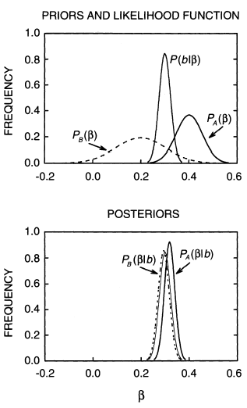
Bayesian updating
Likelihood function
Prior a (tight)
Prior b (diffuse)
Side Note: A Bayesian analysis with infinitely diffuse prior recovers the Frequentist’s maximum likelihood solution (cf. for example, Efron, 1986).
Ellison (1996)

Slide 106
Sequential Bayesian Updating
Prior
Likelihood
Posterior
Probability it will rain given it rained yesterday…
X
…and that it is cloudy this morning
X
…and the wind is coming from the southwest
X

Slide 107
Outline for today
Review of reading assignment
Why may we need a Bayesian approach?
How does a Bayesian approach work?
prior
likelihood
posterior
Bayesian updating
The pesky aspects of computation

Slide 108
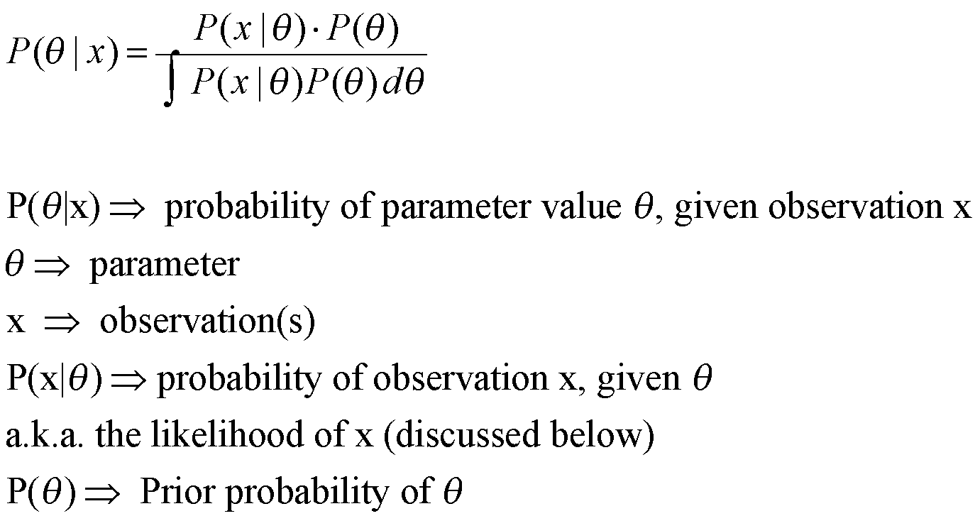
A more general form of Bayes’ rule
Nasty little detail: How to evaluate the pesky little integral…
cf. D’Agostini, 2003, p. 36-37

Slide 109
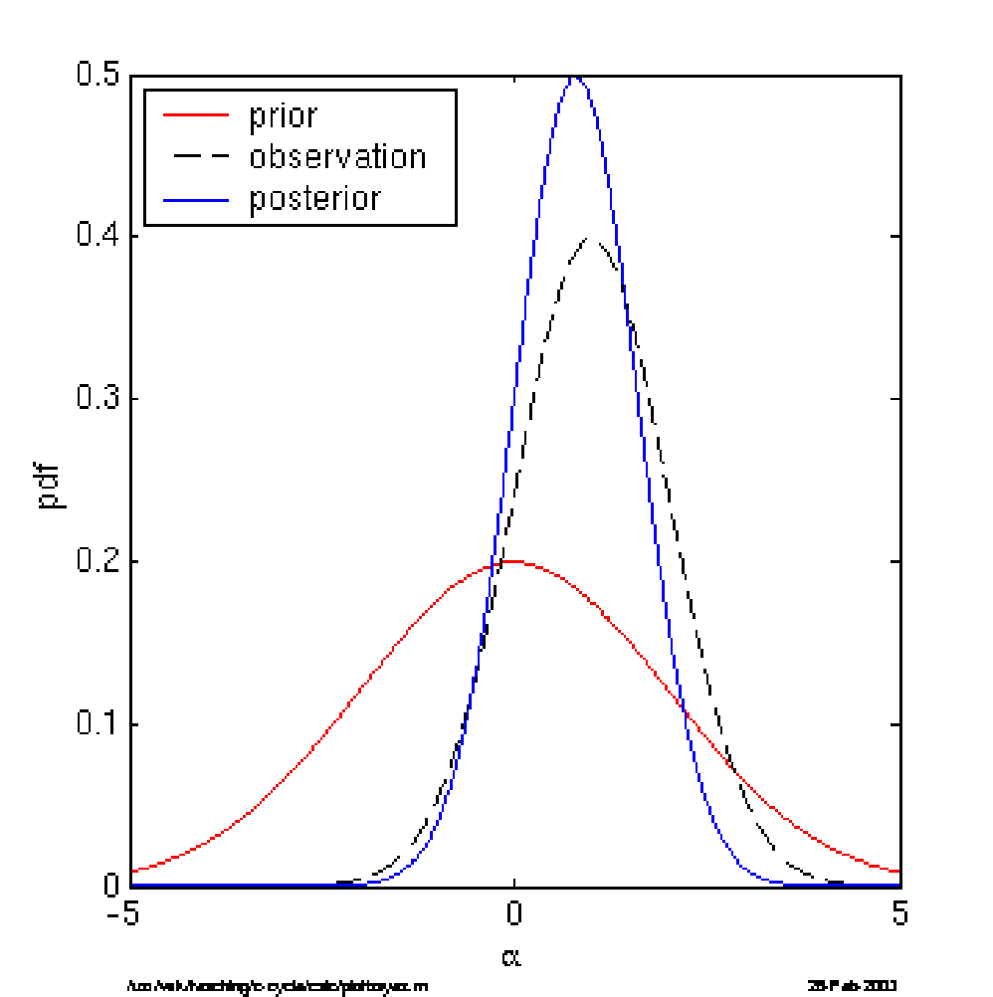
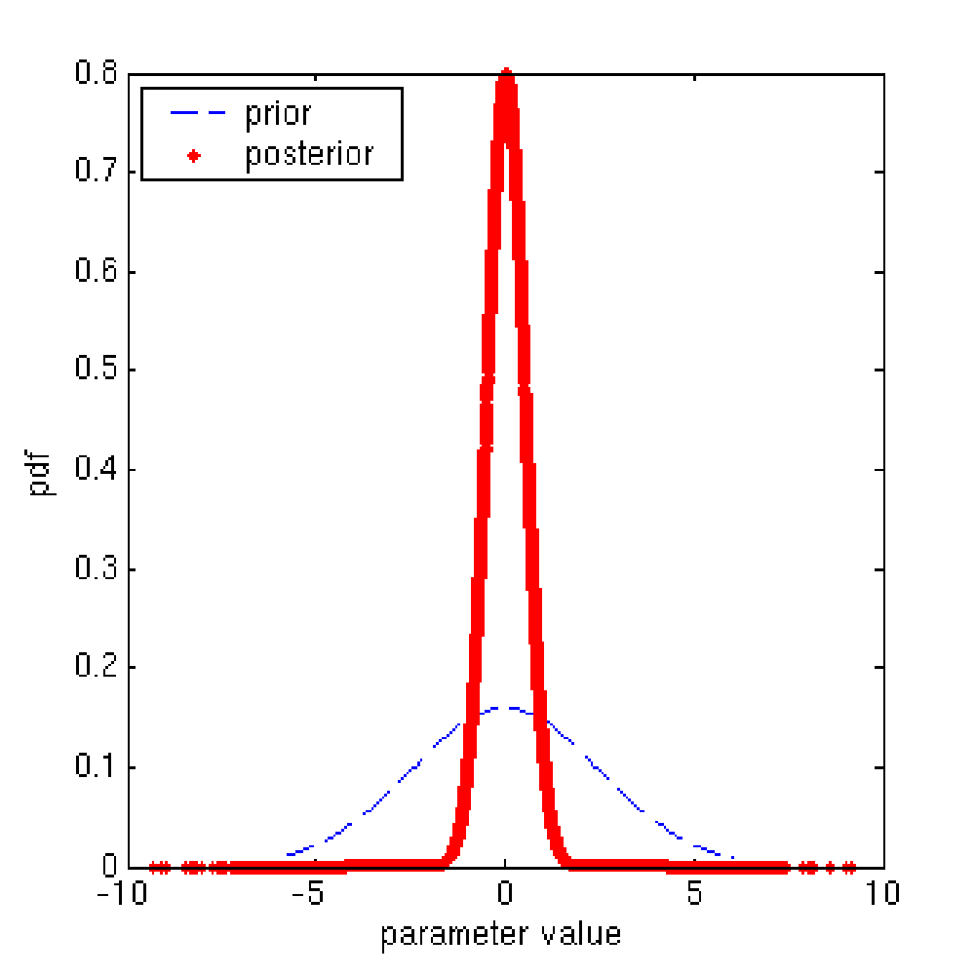
Bayesian updating examples
Using analytical solution, works fine for normal distributions.
Using numerical solution, works fine for all distributions, as long as the dimension of the problem is low and/or the model is fast.

Slide 110

Uncertainty
Characterization
High-dimensional parameter spaces and computationally slow models can pose nontrivial computational challenges for uncertainty characterization.
# Available Model
Evaluations
tails missed
2
Scenarios
10
100
Pre-calibration
1K
MCMC
with
Surrogate
Model
10K
FAMOUS (Lee et al, 2020)
100K
tails sampled
1M
MCMC with Full Model
Uncertainty
Quantification
5
# Uncertain
Parameters
1000
1
20
Figure modified from: Reed, P. M., Hadjimichael, A., Malek, K., Karimi, T., Vernon, C. R., Srikrishnan, V., et al. (2022). Addressing Uncertainty in MultiSector Dynamics Research. Retrieved from https://uc-ebook.org/

Slide 111
Reading Assignments
Core:
NSF. (n.d.). What is GRFP? Retrieved November 29, 2022, from https://www.nsfgrfp.org/
COMPASS Science Communication, Inc. (2017). The Message Box Workbook. COMPASS. Retrieved from https://www.compassscicomm.org/
Supplementary (if you are interested in background)
Stockes, D. E. (1997). Pasteur’s Quadrant. Washington, DC: Brookings Institution Press.
Tijssen, R. J. W. (2018). Anatomy of use-inspired researchers: From Pasteur’s Quadrant to Pasteur’s Cube model. Research Policy, 47(9), 1626–1638. https://doi.org/10.1016/j.respol.2018.05.010
NSF. (n.d.). PROPOSAL AND AWARD POLICIES AND PROCEDURES GUIDE. Retrieved from https://www.nsf.gov/pubs/policydocs/pappg22_1/index.jsp accessed Nov 29 2022

Slide 112
Review
What defines a Frequentist and a Bayesian approach?
What are common errors in statistical inference?
How may a Bayesian approach help you to avoid Type III errors?
What is a prior, likelihood function, and posterior?
Why may it be difficult to perform statistical inference for real-world models?

Slide 113
Reserve Materials

Slide 114
How might a Bayesian approach inform the design of statistical tests?

Slide 115
Bayesian decisions
Example data: Of 5 selections w/o replacement, 1 is Red, 4 are Green
Interpretation:
R/(R+G)|U1=0.9
R/(R+G)|U2=0.95
Observed frequency: 0.2
Urn 1 seems more likely than urn 2, because the frequency of the sample is closer to urn 1 than to urn 2
You get 100$ if you declare urn 2, and it is correct..
You get 1$ if you declare urn1, and it is correct.
Which urn should you declare?
90 Red
10 Green
95 Red
5 Green
Urn 1
Urn 2
Let’s play a game:
- You can sample a single urn 5 times w/o replacement.
You know it is either urn 1 or urn 2
You have to declare which urn you think you have sampled.
You get a reward if you declared the correct urn.
Heavily modified from ftp.stat.duke.edu/Users/db/DOE_in_Charleston.ppt

Slide 116
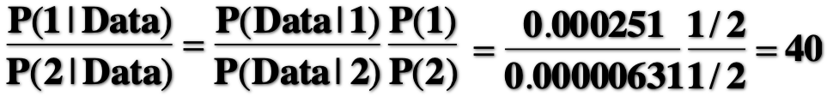
P(1 | Data) is proportional to P(Data |1) P(1) (simplified notation of Bayes’ rule)
P(Data | 1) = 2.51E–4
P(Data | 2) = 6.31E–6 (from closed form pdf, look it up in any solid textbook)
Priors -> ignorant, hence P(1)=P(2)=0.5
Posterior likelihood ratio:
Urn 1 is 40 times as likely than urn 2, if the game is not rigged.
But, the losses associated with being wrong on the two urns are asymetric.
A maximum likelihood analysis suggests urn 1.
What does a maximum payoff analysis suggest?
Modified from ftp.stat.duke.edu/Users/db/DOE_in_Charleston.ppt

Slide 117
“A Frequentist uses impeccable logic to answer
the wrong question, while a Bayesian answers
the right question by making assumptions that
nobody can fully believe in.”
P.G. Hamer
conferences.fnal.gov/cl2k/copies/prosper1.ppt

Slide 118
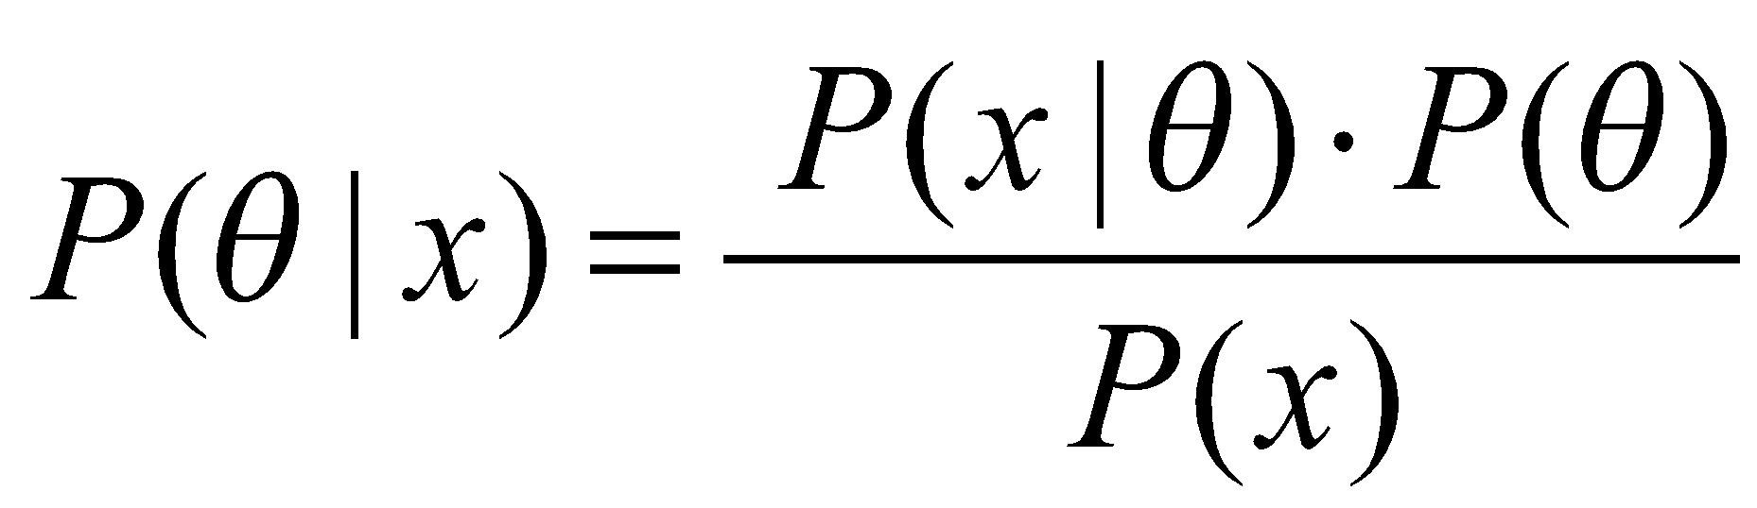
Where do we get the likelihood from?
P(x|θ)
θ₁
θ₂
x
θ₃
P(x, θ)
x
θ₁
θ₂
θ₃
θ

Slide 119
Where do we get the likelihood from?
P(x|θ)
P(x|θ)
θ₁
x₁
θ₂
x
x₂
θ
θ₃
P(x, θ)
x
x₂
x₁
θ₁
θ₂
θ₃
θ

Slide 120
Web-Resources
http://www.bayesian.org
Webpage with links to software and resources
http://astrosun.tn.cornell.edu/staff/loredo/bayes/
Excellent overview with many useful links.
http://www.youtube.com/user/TheScienceguy3000
Many vidoes Bayesian techniques (…and machine learning, object tracking, MCMC, w/Matlab examples)

Slide 121
Books (in increasing order of complexity)
Sivia, D. S. 1996. Data analysis: A Bayesian tutorial. Oxford: Clarendon (Oxford Univ. Press).
D'Agostini, G. 2003. Bayesian reasoning in data analysis: A critical introduction. Singapore: World Scientific Publishing.
Gilks, W. R., S. Richardson, and D. J. Spiegelhalter. 1996. Markov chain monte carlo in practice. London: Chapman and Hall.

Slide 122
ENGG 107: Bayesian Statistical Modeling and Computation
Designing a Project
(Meeting #4)
Objectives for today:
Review motivation and logistics for the project
Discuss how to choose a topic and scope
Review good practice for report and proposal writing

Slide 123
Current Schedule
Week | Week starting | Class 1 | Class 2 | Class 3 | Notes | Assignment out | Assignment due
1 | January 2, 2023 | No Class | Introduction to the class | Bayesian Approach I |  |  | none
2 | January 9, 2023 | Bayesian Approach II | Designing a project | Setting up Computation |  | 1 | none
3 | January 16, 2023 | No class (MLK day) | Analytical Solutions / Intuition | Bayesian Workflow Intro |  | 2 | 1
4 | January 23, 2023 | Precalibration /(Bayes) MC | MCMC Part 1 | MCMC Part 2 | discuss student ideas | 3 | 2
5 | January 30, 2023 | Students pitch project ideas | Writing a method section | Catching up / review |  | 4 | 3
6 | February 6, 2023 | Convergence diagnostics | Checking Assumptions | Deep Uncertainty |  | 5 | 4
7 | February 13, 2023 | Getting Solid Priors | Links to Decision-Making | Links to Decision-Making |  | 6 | 5
8 | February 20, 2023 | Model Choice | Emulation | Sensitivity analysis |  | 7 | 6
9 | February 27, 2023 | Communication of results | Student Presentations | Student Presentations |  | 8 | 7
10 | March 6, 2023 | Class Debriefing / Resarch links | No Class | No Class |  | none | 8

Slide 124
Review Reading Assignments
Core:
NSF. (n.d.). What is GRFP? Retrieved November 29, 2022, from https://www.nsfgrfp.org/
COMPASS Science Communication, Inc. (2017). The Message Box Workbook. COMPASS. Retrieved from https://www.compassscicomm.org/
Supplementary (if you are interested in background)
Stockes, D. E. (1997). Pasteur’s Quadrant. Washington, DC: Brookings Institution Press.
Tijssen, R. J. W. (2018). Anatomy of use-inspired researchers: From Pasteur’s Quadrant to Pasteur’s Cube model. Research Policy, 47(9), 1626–1638. https://doi.org/10.1016/j.respol.2018.05.010
NSF. (n.d.). PROPOSAL AND AWARD POLICIES AND PROCEDURES GUIDE. Retrieved from https://www.nsf.gov/pubs/policydocs/pappg22_1/index.jsp accessed Nov 29 2022

Slide 125
Outline for today
Why do a project?
How to choose a topic?
How to choose the scope?
How to write the report / proposal?

Slide 126
Outline for today
Why do a project?
How to choose a topic?
How to choose the scope?
How to write the report / proposal?

Slide 127
Why do a class project?
Doing reveals more than watching
Establish your own workflow and toolset
Obtain feedback in a supportive and relatively low stakes environment.
Refine an existing project
Start with a paper / proposal

Slide 128
Outline for today
Why do a project?
How to choose a topic?
How to choose the scope?
How to write the report / proposal?

Slide 129
How to choose a project topic?
Is it fun, interesting, and exciting?
Does it have intellectual merit?
Does it provide broader impacts?
Does it provide benefits for you?
skills
tools
building blocks

Slide 130
Outline for today
Why do a project?
How to choose a topic?
How to choose the scope?
How to write the report / proposal?

Slide 131
How to choose a project scope?
What are the options? (note that these are individual projects)
analysis report
proposal
How much time does each option require?
How much time can you commit to this?
Consider your track record in estimating project completion times*?
*Buehler, R., Griffin, D., & Ross, M. (1994). Exploring the “planning fallacy”: Why people underestimate their task completion times. Journal of Personality and Social Psychology, 67(3), 366–381. https://doi.org/10.1037/0022-3514.67.3.366

Slide 132
Outline for today
Why do a project?
How to choose a topic?
How to choose the scope?
How to write the report / proposal?

Slide 133
What to do if the birds hit?
https://www.youtube.com/watch?v=-6HYMpmxdaA
Use a checklist…

Slide 134
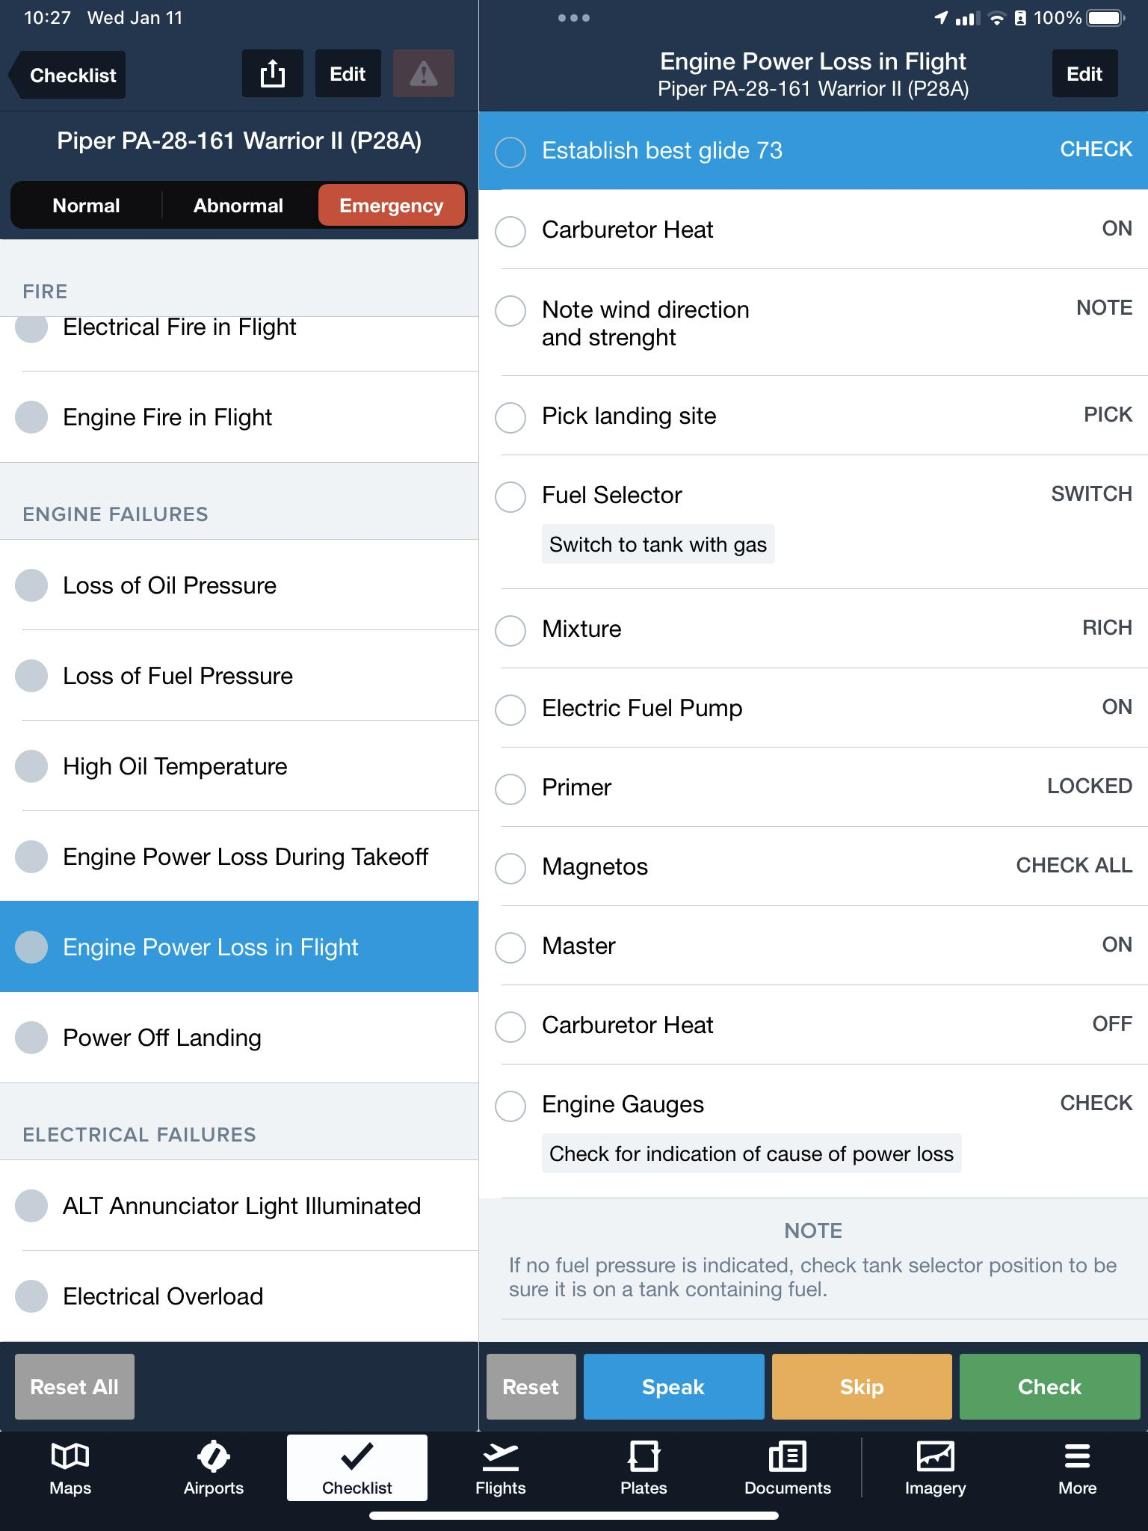
What to do if the propellor stops?
Screenshot from foreflight app.

Slide 135
Use checklists
Example style checklist
Example paper formatting and figure design checklist
Example analysis workflow checklist
Example proposal checklist
Please review these checklists. We’ll get back to them…

Slide 136
The proposal format
The proposal will follow the NSF proposal preparation guide.
Please use the two page NSF graduate fellowship program format
The assessment will follow NSF review criteria.
Describes a novel and feasible project,
contains sufficient details such that a reviewer can judge the project,
is clear and explicit on how the project would improve on previous work,
specifies testable hypotheses
discusses the expected results

Slide 137
How to write a scientific proposal
Identify and describe the conceptual framework of the research question.
Review the previous work.
Articulate the research question given the existing body of knowledge.
Formulate a set of testable hypotheses to address the research question.
Design studies to test the hypotheses.
Evaluate potential outcomes of the study and where they might lead in terms of the hypotheses and the research question.
Synthesise these thoughts in a concise, coherent, and exiting proposal.
Submit and respond to the reviewers comments.
modified from Friedland and Folt (2000)

Slide 138
Where do I get examples and more guidance on the NSF fellowship format?
https://mitcommlab.mit.edu/cheme/commkit/nsf-fellowship-research-proposal/
https://www.alexhunterlang.com/nsf-fellowship
https://danlurie.org/2018/07/example-of-a-successful-nsf-grfp-application/
…

Slide 139
Typical (note changes for Graduate Fellowship call) proposal elements
Project summary (the most important part)
Project description (the meat of the proposal)
Results from prior support
Problem statement and significance
Introduction and background
Literature review
Preliminary results
Conceptual model/framework
Research Plan
Overview
Objectives, hypotheses, and methods
Analysis and expected results
Timetable
References
Biographical sketches
Budget
Current and pending support
Description of facilities
modified from Friedland and Folt (2000)

Slide 140
Get at least two important points across in your proposal
Research Quality (intellectual merits)
What are your strengths?
How will you be innovative in your approach?
Impact of the Research
Broader impact on education through life-long learning, K-12 outreach, teacher training, etc.
Broader impact on society through the environment, economy, energy, etc.
Source: NSF

Slide 141
Why should your proposal be funded?
Exciting and new question
Uniquely qualified to perform the research
Exclusive access to crucial data
Proven track record
Broader impacts
....

Slide 142
Common proposal “rooms for growth”
Failure to establish the importance of the work (intellectual merit and broader impacts)
No testable hypothesis
Too many hypotheses
Weak questions
Loose ends (or potentially serious problems which are not addressed).
Inadequate skills of the PI (at least in the eyes of the reviewers).
Inappropriate methods
Poor attention to procedural and formal requirements
Deadlines, format, typos, bad figure design
Missing references
Alienating the reviewers

Slide 143
Approaches you may want to avoid
Trashing all previous work, especially of potential reviewers. “All the previous studies are based on flawed methods, unclear thinking. Keller et al (2000) provide an example of a particularly stupid approach.
Not being specific. “We will address the problem of global warming”
Having a nonspecific, cryptic, or very long title. “Global warming and ICSXXSVC in general”.
Assuming everybody shares your view. “As every smart person will concede, global warming is the most important problem.”
Not proposing a testable hypothesis. “We will analyze the global NDVI and temperature data to explore possible mechanisms to explain the missing carbon sink”.
Not giving credit for previous work. “The climate sensitivity lies between 1.5 and 4.5 ºC.”

Slide 144
Potential Useful Sources
“NSF proposal writing tips” (www.nsf.gov).
“A guide for proposal writing” (www.nsf.gov).
“Grantmanship hints”, Agronomy Journal, 92, 1-5 (2000).
“Writing successful science proposals”, Friedland and Folt, Yale University Press (2000).

Slide 145
Assignments for Next Class
Please use the links (R and RStudio) to download and install the latest versions of R and RStudio for your preferred operating system.
Bring your laptop with the install (If you cannot use R locally, R is available on the Thayer Linux systems located in MacLean 210 and Cummings G13.
Please review Lab#0 in Applegate and Keller (2016) (and ignore the “SWIRL” part)
Please review: “An Introduction to R” => http://cran.r-project.org/doc/contrib/Lam-IntroductionToR_LHL.pdf
Please review simpleR - Using R for Introductory Statistics”
=> http://cran.r-project.org/doc/contrib/Verzani-SimpleR.pdf

Slide 146
Review
Do you know
What are possible deliverables for your class project?
What to consider when choosing
a topic, and
your project scope?
What are good practices for paper and proposal writing?
Where to find potentially useful checklists?

Slide 147
Reserve Materials

Slide 148
Reviewing proposals
Don’t be overly harsh. This is not an article and many can guess pretty well who wrote the killing review.
Focus on constructive critique.
Two review criteria:
What is the intellectual merit of the proposal?
What are the broader impacts of the proposed activity?

Slide 149
The Project Summary is the MOST important page. It may be the only page that people read!
State your research objectives.
Explain how you will do the research and why it is needed.
Broader impact on education and society?
What are your particular strengths?
Will there be any collaboration with industry or other universities?
Be concise and persuasive!
Source: NSF

Slide 150
ENGG 107: Bayesian Statistical Modeling and Computation
Setting up computation
(Meeting #5)
Motivating questions for today:
How to install and use R and R-Studio?
How to learn R syntax?
How to document your analysis?
How to make your analysis method FAIR?

Slide 151
Current Schedule
Week | Week starting | Class 1 | Class 2 | Class 3 | Notes | Assignment out | Assignment due
1 | January 2, 2023 | No Class | Introduction to the class | Bayesian Approach I |  |  | none
2 | January 9, 2023 | Bayesian Approach II | Designing a project | Setting up Computation |  | 1 | none
3 | January 16, 2023 | No class (MLK day) | Analytical Solutions / Intuition | Bayesian Workflow Intro |  | 2 | 1
4 | January 23, 2023 | Precalibration /(Bayes) MC | MCMC Part 1 | MCMC Part 2 | discuss student ideas | 3 | 2
5 | January 30, 2023 | Students pitch project ideas | Writing a method section | Catching up / review |  | 4 | 3
6 | February 6, 2023 | Convergence diagnostics | Checking Assumptions | Deep Uncertainty |  | 5 | 4
7 | February 13, 2023 | Getting Solid Priors | Links to Decision-Making | Links to Decision-Making |  | 6 | 5
8 | February 20, 2023 | Model Choice | Emulation | Sensitivity analysis |  | 7 | 6
9 | February 27, 2023 | Communication of results | Student Presentations | Student Presentations |  | 8 | 7
10 | March 6, 2023 | Class Debriefing / Resarch links | No Class | No Class |  | none | 8

Slide 152
Assignments Review
Please use the links (R and RStudio) to download and install the latest versions of R and RStudio for your preferred operating system.
Bring your laptop with the install (If you cannot use R locally, R is available on the Thayer Linux systems located in MacLean 210 and Cummings G13.
Please review Lab#0 in Applegate and Keller (2016) (and ignore the “SWIRL” part)
Please review: “An Introduction to R” => http://cran.r-project.org/doc/contrib/Lam-IntroductionToR_LHL.pdf
Please review simpleR - Using R for Introductory Statistics”
=> http://cran.r-project.org/doc/contrib/Verzani-SimpleR.pdf

Slide 153
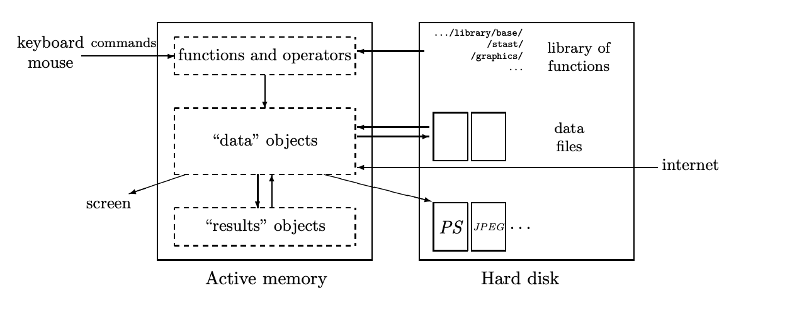
Why R?
R is an interpreted language, not a compiled one.
R’s syntax is simple and intuitive. For example, Linear Regression can be done with the command lm(y ~ x).
All the actions of R are done on objects stored in the active memory of the computer: no temporary files are used. The readings and writings of files are used for input and output of data and results (graphics, . . .).
A schematic view of how R works
Images from : https://cran.r-project.org/doc/contrib/Paradis-rdebuts_en.pdf

Slide 154
Questions for today
How to install and use R and R-Studio?
How to learn R syntax?
How to document your analysis?
How to make your analysis method FAIR?

Slide 155
Questions for today
How to install and use R and R-Studio?
How to learn R syntax?
How to document your analysis?
How to make your analysis method FAIR?

Slide 156
How to install R and R-studio?
https://rstudio-education.github.io/hopr/starting.html

Slide 157
Questions for today
How to install and use R and R-Studio?
How to learn R syntax?
How to document your analysis?
How to make your analysis method FAIR?

Slide 158
How to learn R syntax?
Review Lab#0 in Applegate and Keller (2016) (and ignore the “SWIRL” part)
Review: “An Introduction to R” => http://cran.r-project.org/doc/contrib/Lam-IntroductionToR_LHL.pdf
Review simpleR - Using R for Introductory Statistics”
=> http://cran.r-project.org/doc/contrib/Verzani-SimpleR.pdf

Slide 159
Questions for today
How to install and use R and R-Studio?
How to learn R syntax?
How to document your analysis?
How to make your analysis method FAIR?

Slide 160
How to document your analysis?
Decide on GUI vs workbook vs script
Use of repositories and version control systems
Document your code with comments

Slide 161
Questions for today
How to install and use R and R-Studio?
How to learn R syntax?
How to document your analysis?
How to make your analysis method FAIR?

Slide 162
What is a FAIR analysis?
Findable, Accessible, Interpretable, Reproducible
Chue Hong, N. P., Katz, D. S., Barker, M., Lamprecht, A.-L., Martinez, C., Psomopoulos, F. E., et al. (2022). FAIR Principles for Research Software (FAIR4RS Principles). https://doi.org/10.15497/RDA00068
Munafò, M. R., Nosek, B. A., Bishop, D. V. M., Button, K. S., Chambers, C. D., Du Sert, N. P., et al. (2017). A manifesto for reproducible science. Nature Human Behaviour, 1(1), 1–9. Retrieved from https://www.nature.com/articles/s41562-016-0021%C3%82%C2%A0
Stark, P. B. (2018). Before reproducibility must come preproducibility. Nature, 557(7707), 613. https://doi.org/10.1038/d41586-018-05256-0
Wicherts, J. M., Bakker, M., & Molenaar, D. (2011). Willingness to share research data is related to the strength of the evidence and the quality of reporting of statistical results. PloS One, 6(11), e26828. https://doi.org/10.1371/journal.pone.0026828
Wilkinson, M. D., Dumontier, M., Aalbersberg, I. J. J., Appleton, G., Axton, M., Baak, A., et al. (2016). The FAIR Guiding Principles for scientific data management and stewardship. Scientific Data, 3, 160018. https://doi.org/10.1038/sdata.2016.18

Slide 163
Where to go for resources?
CRAN Task View Bayesian Inference
LaplacesDemon: Complete Environment for Bayesian Inference
abc: Tools for Approximate Bayesian Computation (ABC)
Applegate, P. J., & Keller, K. (Eds.). (2016). Risk analysis in the Earth Sciences: A Lab manual. 2nd edition. Leanpub.
LearnBayes: Functions for Learning Bayesian Inference

Slide 164
Let’s dive into a simple example analysis
Motivating question: Is this coin fair?
Technical analysis:
###########################################################
# problem definition:
# You flip a coin 500 times
# Heads=1, Tails=0
# What do you expect as a mean outcome?
# What is a 95% confidence interval for this mean outcome?
########################################################
#########
Approaches:
- Make a flow diagram of the method
- sketch the figures you want to produce
- review the function “sample”
- recycle the old script components
- hack away and test
- document…

Slide 165
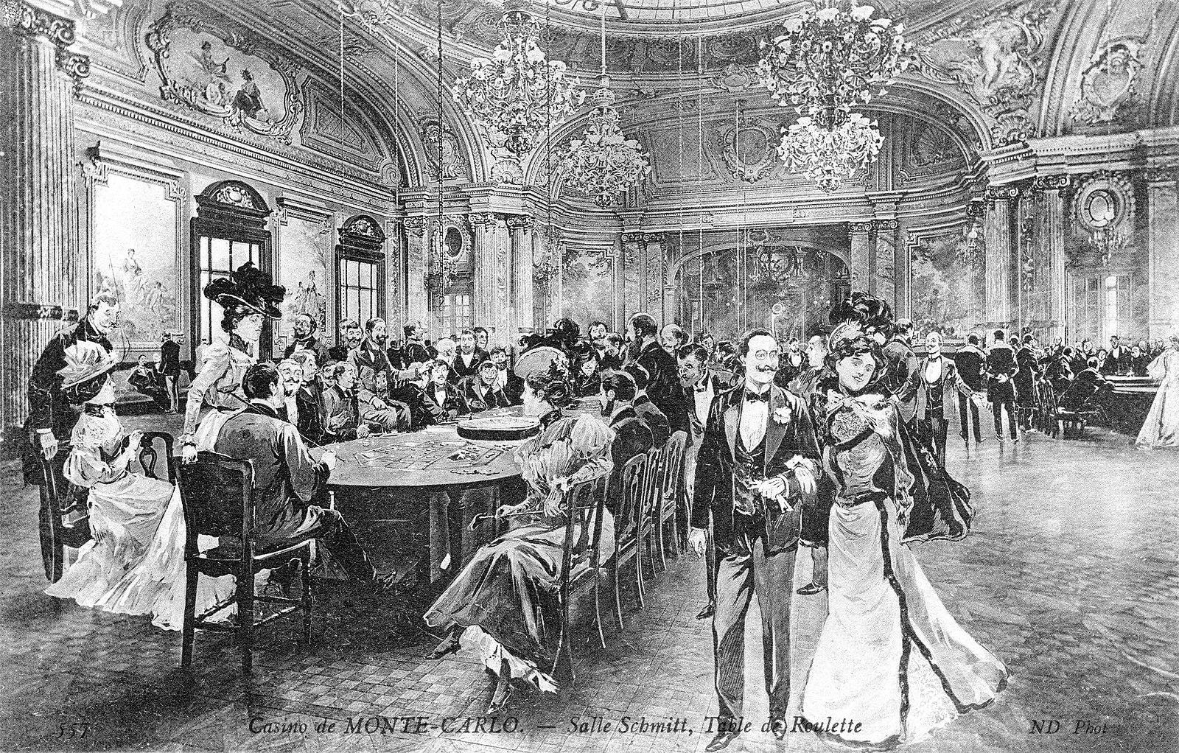
Monte Carlo to the rescue
Picture: “Postcard showing an engraving of the roulette table in the Salle Schmitt (now the Salle Europe), Monte Carlo Casino – Neurdein Brothers, Paris c.1910.” Public domain. https://commons.wikimedia.org/wiki/File:Table_de_Roulette,_Casino_de_Monte_Carlo_(Carte_Postale_Ancienne).jpg, accessed Jan 13 2023

Slide 166
Monte Carlo for Nerds
“Monte Carlo methods, or Monte Carlo experiments, are a broad class of computational algorithms that rely on repeated random sampling to obtain numerical results. The underlying concept is to use randomness to solve problems that might be deterministic in principle. They are often used in physical and mathematical problems and are most useful when it is difficult or impossible to use other approaches. Monte Carlo methods are mainly used in three problem classes:^{[1]} optimization, numerical integration, and generating draws from a probability distribution.”
quote: https://en.wikipedia.org/wiki/Monte_Carlo_method, accessed Jan 13 2023

Slide 167
Quick Thought Experiment:
How to use a Monte Carlo method to estimate the numerical value of Pi (with uncertainty)

Slide 168
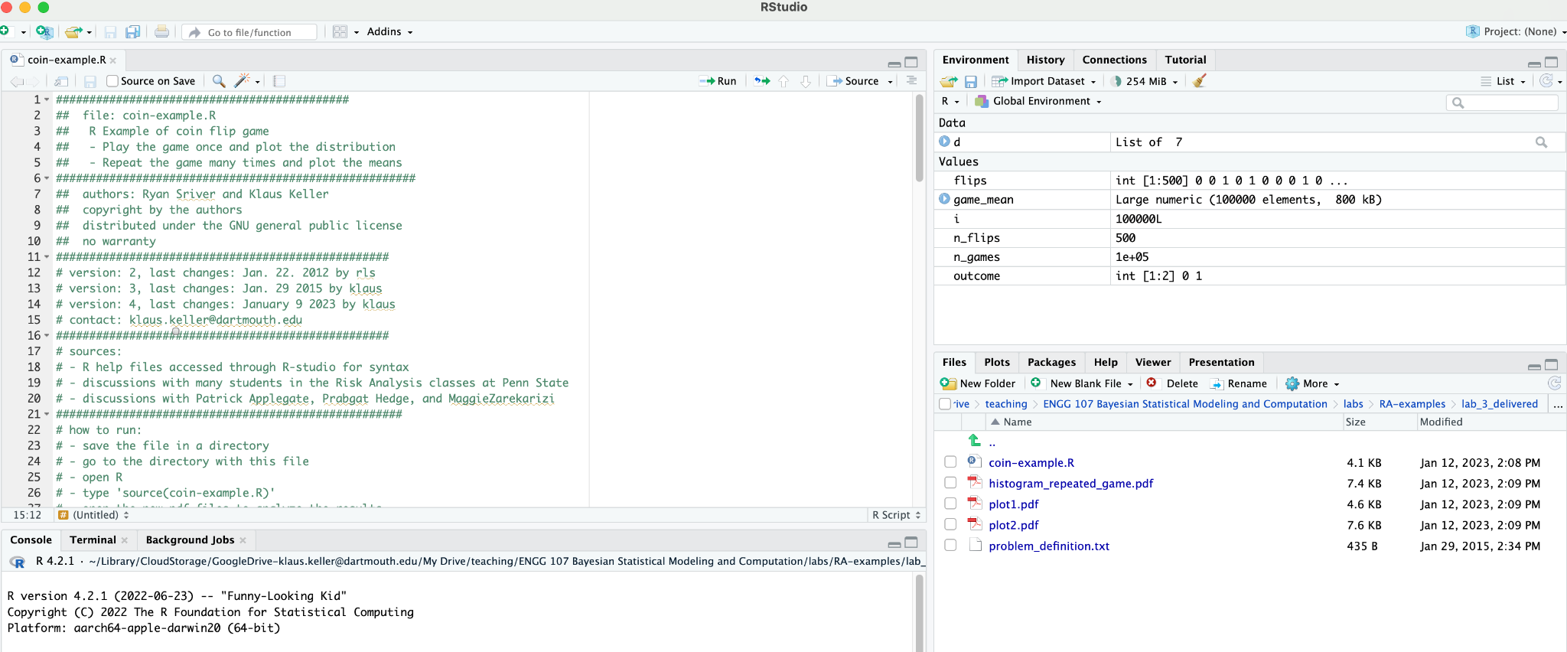
Let’s dive into a code example

Slide 169
Reading Assignments for Next Class
Core:
D’Agostini, G. (2003). Bayesian reasoning in data analysis: A critical introduction. Singapore: World Scientific Publishing. (Chapter 6, an easy and elegant introduction).
Supplementary (if you are interested in background)
Pei, Y., Biswas, S., Fussell, D. S., & Pingali, K. (2019). An elementary introduction to Kalman filtering. Communications of the ACM, 62(11), 122–133. https://doi.org/10.1145/3363294
Kalman Filter. (n.d.). Retrieved November 29, 2022, from https://en.wikipedia.org/wiki/Kalman_filter
Chen, Z., & Others. (2003). Bayesian filtering: From Kalman filters to particle filters, and beyond. Statistics, 182(1), 1–69.

Slide 170
Review
Do you know
How to install R and R-Studio?
How to learn R syntax?
What is a FAIR analysis?
Why you may want to opt for a FAIR analysis?
How to run, read, and reproduce an example analysis script?

Slide 171
Reserve Materials

Slide 172
ENGG 107: Bayesian Statistical Modeling and Computation
Wrapping up Bayes/ Analytical Solutions
(meeting #6)
Objectives for today:
Learn key concepts of analytical solutions to Bayesian inference
Learn implementation approaches for these analytical solutions
Identify strengths and weaknesses of these analytical approaches.

Slide 173
Draft Schedule
Week | Week starting | Class 1 | Class 2 | Class 3 | Notes | Assignment out | Assignment due
1 | January 2, 2023 | No Class | Introduction to the class | Bayesian Approach I |  |  | none
2 | January 9, 2023 | Bayesian Approach II | Designing a project | Setting up Computation |  | 1 | none
3 | January 16, 2023 | No class (MLK day) | Analytical Solutions / Intuition | Bayesian Workflow Intro |  | 2 | 1
4 | January 23, 2023 | Precalibration /(Bayes) MC | MCMC Part 1 | MCMC Part 2 | discuss student ideas | 3 | 2
5 | January 30, 2023 | Students pitch project ideas | Writing a method section | Catching up / review |  | 4 | 3
6 | February 6, 2023 | Convergence diagnostics | Checking Assumptions | Deep Uncertainty |  | 5 | 4
7 | February 13, 2023 | Getting Solid Priors | Links to Decision-Making | Links to Decision-Making |  | 6 | 5
8 | February 20, 2023 | Model Choice | Emulation | Sensitivity analysis |  | 7 | 6
9 | February 27, 2023 | Communication of results | Student Presentations | Student Presentations |  | 8 | 7
10 | March 6, 2023 | Class Debriefing / Resarch links | No Class | No Class |  | none | 8

Slide 174
Review of Reading Assignments
Core:
D’Agostini, G. (2003). Bayesian reasoning in data analysis: A critical introduction. Singapore: World Scientific Publishing. (Chapter 6, an easy and elegant introduction).
Supplementary (if you are interested in background and/or applications)
Kalman Filter. (n.d.). Retrieved November 29, 2022, from https://en.wikipedia.org/wiki/Kalman_filter
Chen, Z., & Others. (2003). Bayesian filtering: From Kalman filters to particle filters, and beyond. Statistics, 182(1), 1–69.
Pei, Y., Biswas, S., Fussell, D. S., & Pingali, K. (2019). An elementary introduction to Kalman filtering. Communications of the ACM, 62(11), 122–133. https://doi.org/10.1145/3363294
Enting, I. G., Trudinger, C. M., & Francey, R. J. (1995). A synthesis inversion of the concentration and delta ^13C of atmospheric CO₂. Tellus Ser. B., 47, 35–52.

Slide 175
Outline for today
How does a Bayesian approach work?
prior
likelihood
posterior
Bayesian updating
The pesky aspects of computation
What are examples of analytical approaches?
What are assumptions for these approaches?
What are advantages of analytical approaches?
When not to rely on analytical approaches?

Slide 176
Outline for today
How does a Bayesian approach work?
prior
likelihood
posterior
Bayesian updating
The pesky aspects of computation
What are examples of analytical approaches?
What are assumptions for these approaches?
What are advantages of analytical approaches?
When not to rely on analytical approaches?

Slide 177
Where do we get the likelihood from?
A likelihood is a conditional probability.
P(rain) = 0.3 (probability)
P(rain | rain yesterday) = 0.6 (conditional probability a.k.a. likelihood)
careful, in standard english, likelihood is sometimes used synonymously with
Remember the yodeling calculation from your fellow student?
“P(A|B) = P(B|A) * P(A) / P(B) = 98% * 0.5% / (98% * 0.5% + 2% * 99.5%) ≈ 0.5% / (0.5% + 2%) = 0.5 / (0.5 + 2) = 20%
A: Have the trait
B: Tested positive in one test”
For a single observation and just observation errors, the likelihood is just the pdf of the observation error.
For N independent observations, the likelihood is the product of the single pdf values.
Why is the assumption of independence important?
How can one test this assumption?
cf. Wilks, p. 19, 108, Ang Xiao

Slide 178
Bayesian updating
Likelihood function
Prior a (tight)
Prior b (diffuse)
Side Note: A Bayesian analysis with infinitely diffuse prior recovers the Frequentist’s maximum likelihood solution (cf. for example, Efron, 1986).
Ellison (1996)

Slide 179
Sequential Bayesian Updating
Prior
Likelihood
Posterior
Probability it will rain given it rained yesterday…
X
…and that it is cloudy this morning
X
…and the wind is coming from the southwest
X

Slide 180
Outline for today
How does a Bayesian approach work?
prior
likelihood
posterior
Bayesian updating
The pesky aspects of computation
What are examples of analytical approaches?
What are assumptions for these approaches?
What are advantages of analytical approaches?
When not to rely on analytical approaches?

Slide 181
A more general form of Bayes’ rule
Nasty little detail: How to evaluate the pesky little integral…
cf. D’Agostini, 2003, p. 36-37

Slide 182
Bayesian updating examples
Using analytical solution, works fine for normal distributions.
Using numerical solution, works fine for all distributions, as long as the dimension of the problem is low and/or the model is fast.

Slide 183
Uncertainty
Characterization
High-dimensional parameter spaces and computationally slow models can pose nontrivial computational challenges for uncertainty characterization.
# Available Model
Evaluations
tails missed
2
Scenarios
10
100
Pre-calibration
1K
MCMC
with
Surrogate
Model
10K
Figure: Reed, P. M., Hadjimichael, A., Malek, K., Karimi, T., Vernon, C. R., Srikrishnan, V., et al. (2022). Addressing Uncertainty in MultiSector Dynamics Research. Retrieved from https://uc-ebook.org/
FAMOUS (Lee et al, 2020)
100K
tails sampled
1M
MCMC with Full Model
Uncertainty
Quantification
5
# Uncertain
Parameters
1000
1
20
Background: Lee, B. S., Haran, M., Fuller, R. W., Pollard, D., & Keller, K. (2020). A fast particle-based approach for calibrating a 3-D model of the Antarctic ice sheet. The Annals of Applied Statistics, 14(2), 605–634. https://doi.org/10.1214/19-AOAS1305
Sharma, S., Lee, B. S., Hosseini-Shakib, I., Haran, M., & Keller, K. (2023). Neglecting model parametric uncertainty can drastically underestimate flood risks. Earth’s Future, 11(1). https://doi.org/10.1029/2022ef003050

Slide 184
Outline for today
How does a Bayesian approach work?
prior
likelihood
posterior
Bayesian updating
The pesky aspects of computation
What are examples of analytical approaches?
What are assumptions for these approaches?
What are advantages of analytical approaches?
When not to rely on analytical approaches?

Slide 185
What are examples of analytical approaches?
Closed form likelihood function with
improper prior
uniform prior
conjugate prior
Kalman Filter
“Synthesis inversion” (Enting 1995)
Enting, I. G., Trudinger, C. M., & Francey, R. J. (1995). A synthesis inversion of the concentration and delta ^13C of atmospheric CO₂. Tellus Ser. B., 47, 35–52.

Slide 186
Outline for today
How does a Bayesian approach work?
prior
likelihood
posterior
Bayesian updating
The pesky aspects of computation
What are examples of analytical approaches?
What are key assumptions for these approaches?
What are advantages of analytical approaches?
When not to rely on analytical approaches?

Slide 187
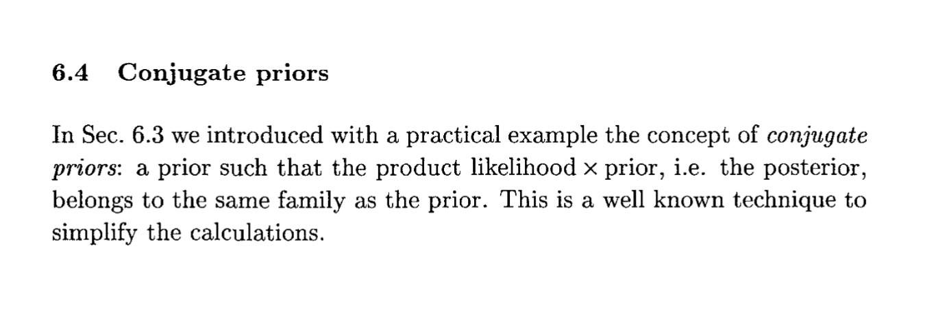
What are conjugate priors?
D’Agostini, G. (2003). Bayesian reasoning in data analysis: A critical introduction. Singapore: World Scientific Publishing.

Slide 188
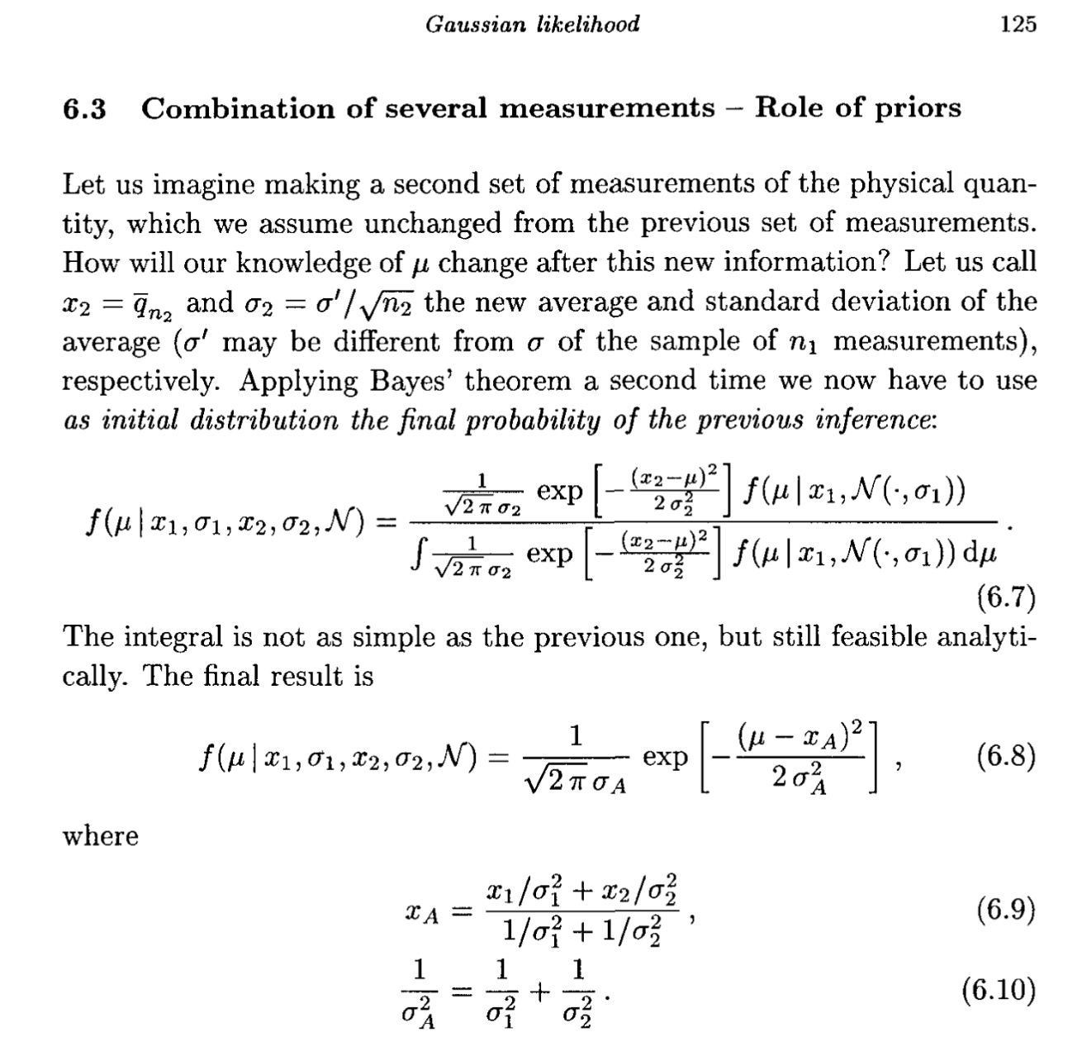
Simple case of Gaussian Priors and Gaussian Likelihood Function
D’Agostini (Ed.). (2003). Gaussian Likelihood. In Bayesian Reasoning in Data Analysis (pp. 123–139). World Scientific.

Slide 189
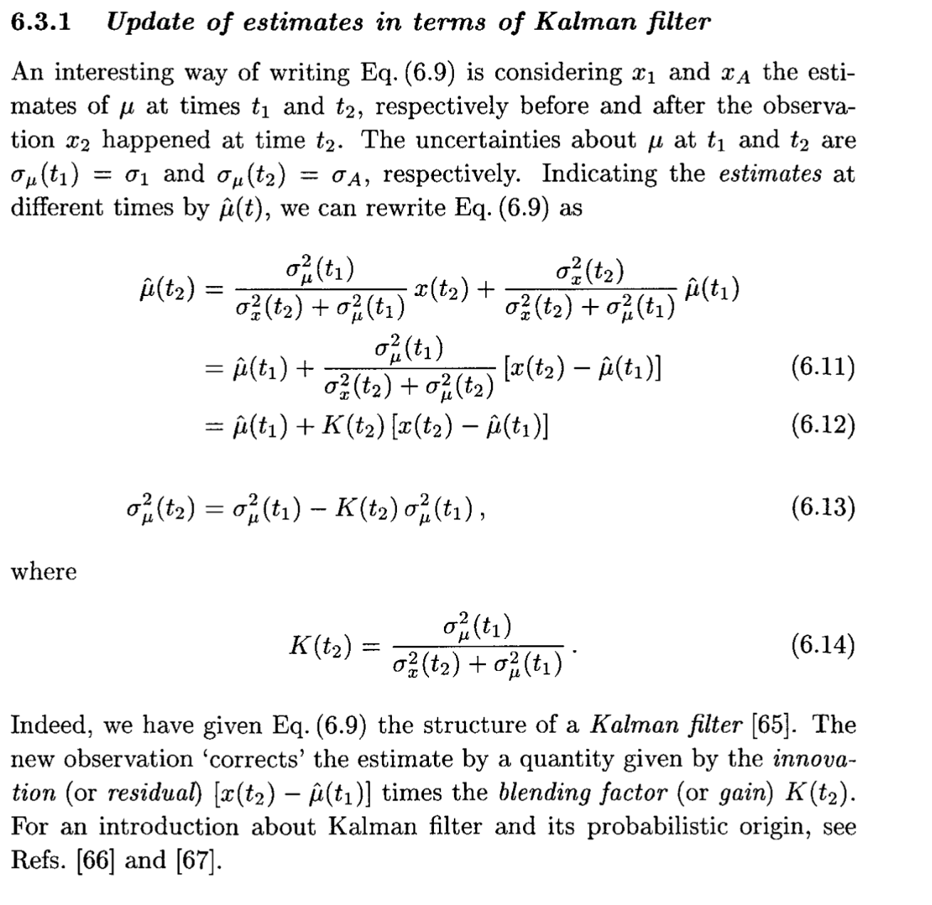
Link to the Kalman Filter
D’Agostini (Ed.). (2003). Gaussian Likelihood. In Bayesian Reasoning in Data Analysis (pp. 123–139). World Scientific.

Slide 190
Outline for today
How does a Bayesian approach work?
prior
likelihood
posterior
Bayesian updating
The pesky aspects of computation
What are examples of analytical approaches?
What are assumptions for these approaches?
What are advantages of analytical approaches?
When not to rely on analytical approaches?

Slide 191
Advantages of analytical approaches
Fast and precise
Analytical tractable (insights, …)
Not impacted by numerical artifacts
Can provide a great positive control

Slide 192
Outline for today
How does a Bayesian approach work?
prior
likelihood
posterior
Bayesian updating
The pesky aspects of computation
What are examples of analytical approaches?
What are assumptions for these approaches?
What are advantages of analytical approaches?
When not to rely on analytical approaches?

Slide 193
When not to rely on analytical approaches?
The required assumptions are too poor an approximation.
You cannot find one ;-)

Slide 194
Getting intuition by doing approximate Bayesian analysis by hand

Slide 195
Can you safely make it an airport one flight hour away?
One key input: how much gas do we have?
Imperfect information with priors
Average fuel use=10 gal/hr
Required reserve: 45 minutes when you arrive.
Consider left tank only
Consider left and right tank.
Picture: Klaus Keller

Slide 196
Case studies
Please sketch out your priors, likelihood functions, and posterior(s)
“Kalman”
Observation at 18 gallons with Gaussian standard deviation of 10 gallons
Gaussian prior at 15 gallons, standard deviation of 10 gallons.
“Uniform”
Same observation
Uniform prior of 0 to 25 gallons (empty to full tank, capacity)
“Deep Uncertainty”
Same observation
You and the passenger remember that the person who flew before you in the aircraft did add gas to the tank. Your passenger is certain that the prior pilot was in a hurry and only filled up the tank to ¼ of the capacity just before you take the observation. You, on the other hand, are certain that the previous pilot filled up the tank to the maximum of the capacity.
What priors do you choose to approximate this situation?
What are your posteriors?

Slide 197
Reading Assignments
Core:
Please review carefully the data analysis checklist handout.
Supplementary (if you are interested in background)
Doss-Gollin, J., & Keller, K. (2022). A subjective Bayesian framework for synthesizing deep uncertainties in climate risk management. Earth’s Future. https://doi.org/10.1029/2022ef003044
Gelman, A., Vehtari, A., Simpson, D., Margossian, C. C., Carpenter, B., Yao, Y., et al. (2020, November 3). Bayesian Workflow. arXiv [stat.ME]. Retrieved from http://arxiv.org/abs/2011.01808
Depaoli, S., & van de Schoot, R. (2017). Improving transparency and replication in Bayesian statistics: The WAMBS-Checklist. Psychological Methods, 22(2), 240–261. https://doi.org/10.1037/met0000065

Slide 198
Review - I
What defines a Frequentist and a Bayesian approach?
What are common errors in statistical inference?
How may a Bayesian approach help you to avoid Type III errors?
What is a prior, likelihood function, and posterior?
Why may it be difficult to perform statistical inference for real-world models?

Slide 199
Review II
Do you know
how to interpret and define a prior and a simple likelihood function?
examples and advantages of analytical solutions to the Bayes equation?
reasons to switch to numerical solutions to Bayes equation?
reasons why numerical solutions to Bayes equations may be hard to find?

Slide 200
Reserve Materials

Slide 201
STOP LAST TIME

Slide 202
ENGG 107: Bayesian Statistical Modeling and Computation
A Bayesian Inference Workflow - A First look
Objectives for today:
Recap and solidify the first pass on Bayesian inference
Learn about a (Bayesian) inference workflow

Slide 203
Draft Schedule
Week | Week starting | Class 1 | Class 2 | Class 3 | Notes | Assignment out | Assignment due
1 | January 2, 2023 | No Class | Introduction to the class | Bayesian Approach I |  |  | none
2 | January 9, 2023 | Bayesian Approach II | Designing a project | Setting up Computation |  | 1 | none
3 | January 16, 2023 | No class (MLK day) | Analytical Solutions / Intuition | Bayesian Workflow Intro |  | 2 | 1
4 | January 23, 2023 | Precalibration /(Bayes) MC | MCMC Part 1 | MCMC Part 2 | discuss student ideas | 3 | 2
5 | January 30, 2023 | Students pitch project ideas | Writing a method section | Catching up / review |  | 4 | 3
6 | February 6, 2023 | Convergence diagnostics | Checking Assumptions | Deep Uncertainty |  | 5 | 4
7 | February 13, 2023 | Getting Solid Priors | Links to Decision-Making | Links to Decision-Making |  | 6 | 5
8 | February 20, 2023 | Model Choice | Emulation | Sensitivity analysis |  | 7 | 6
9 | February 27, 2023 | Communication of results | Student Presentations | Student Presentations |  | 8 | 7
10 | March 6, 2023 | Class Debriefing / Resarch links | No Class | No Class |  | none | 8

Slide 204
Outline for today
Recap from last meeting
Why use a Bayesian workflow?
Discussion of a (Bayesian) workflow checklist
Reading and problem set assignments

Slide 205
Outline for today
Recap from last meeting
Why use a Bayesian workflow?
Discussion of a (Bayesian) workflow checklist
Reading and problem set assignments

Slide 206
Reading Assignments from the last meeting
Core:
Please review carefully the data analysis checklist handout.
Supplementary (if you are interested in background)
Doss-Gollin, J., & Keller, K. (2022). A subjective Bayesian framework for synthesizing deep uncertainties in climate risk management. Earth’s Future. https://doi.org/10.1029/2022ef003044
Gelman, A., Vehtari, A., Simpson, D., Margossian, C. C., Carpenter, B., Yao, Y., et al. (2020, November 3). Bayesian Workflow. arXiv [stat.ME]. Retrieved from http://arxiv.org/abs/2011.01808
Depaoli, S., & van de Schoot, R. (2017). Improving transparency and replication in Bayesian statistics: The WAMBS-Checklist. Psychological Methods, 22(2), 240–261. https://doi.org/10.1037/met0000065
Who did which readings?
Summary of the main points?
Relevance to your own work?

Slide 207
Can you safely make it an airport one flight hour away?
One key input: how much fuel do we have?
Imperfect information with priors
Average fuel use=10 gal/hr
Required reserve: 45 minutes when you arrive.
Consider left tank only
Consider left and right tank.
Picture: Klaus Keller

Slide 208
Please sketch out your priors, likelihood functions, and posterior(s)
“Kalman”
Observation at 18 gallons with Gaussian standard deviation of 10 gallons
Gaussian prior at 15 gallons, standard deviation of 10 gallons.
“Uniform”
Same observation
Uniform prior of 0 to 25 gallons (empty to full tank, capacity)
“Deep Uncertainty”
Same observation
You and the passenger remember that the person who flew before you in the aircraft did add gas to the tank. Your passenger is certain that the prior pilot was in a hurry and only filled up the tank to ¼ of the capacity just before you take the observation. You, on the other hand, are certain that the previous pilot filled up the tank to the maximum of the capacity.
What priors do you choose to approximate this situation?
What are your posteriors?

Slide 209
What are example solutions from students?

Slide 210
Outline for today
Recap from last meeting
Why use a Bayesian workflow?
Discussion of a (Bayesian) workflow checklist
Reading and problem set assignments

Slide 211
Why use a checklist?
It can improve decisions and outcome…
Thomassen, Ø., Storesund, A., Søfteland, E., & Brattebø, G. (2014). The effects of safety checklists in medicine: a systematic review. Acta Anaesthesiologica Scandinavica, 58(1), 5–18. https://doi.org/10.1111/aas.12207

Slide 212
Outline for today
Recap from last meeting
Why use a Bayesian workflow?
Discussion of a (Bayesian) workflow checklist
Reading and problem set assignments

Slide 213
Example analysis workflow checklist
This is a working document
Write your own
adapt what you like
add what you need
delete irrelevant or distracting elements
Let’s go through the checklist

Slide 214
1) Setting up the analysis
Legal and ethical questions assessed
Clearly defined question
Link to decision-making established
Possible design errors discussed (types I, II, III, IV)
License defined
Copyright defined
Authors defined

Slide 215
2) Choosing a methods portfolio
Bayesian vs Frequentist chosen
Analytical vs computational approach chosen
Data generating model defined
Likelihood function defined
(Implicit) prior (with correlations) defined
Required approximations defined (Likelihood function, model structure, uncertainties, …)
Assumptions spelled out
Positive controls (across key methods and assumptions) performed
Negative control (across key methods and assumptions) performed
Expected results (with time-stamp) documented

Slide 216
3) Performing the Analysis
Convergence tested (if using numerical methods)
Assumptions tested (e.g., residuals consistent with likelihood function)
Prior prediction checks passed
Posterior predictive checks passed
Size and effects of (deep uncertainties / forking paths) characterized

Slide 217
4) Documenting the Analysis
Authors named and reachable
Environment variables documented
Assumptions and robustness discussed
Code reviewed for logic and consistency with documentation
Figures publication ready
Documentation accessible to intended / target audience(s)
All sources cited
Non-author contributors acknowledged
Funding acknowledged
Conflict of interest declared
Materials uploaded to repository

Slide 218
Outline for today
Recap from last meeting
Why use a Bayesian workflow?
Discussion of a (Bayesian) workflow checklist
Reading and problem set assignments

Slide 219
Reading Assignment for Next Class
Core:
Qian, S. S., Stow, C. A., & Borsuk, M. E. (2003). On Monte Carlo methods for Bayesian inference. Ecological Modelling, 159(2-3), 269–277.
Ruckert, K. L., Shaffer, G., Pollard, D., Guan, Y., Wong, T. E., Forest, C. E., & Keller, K. (2017). Assessing the Impact of Retreat Mechanisms in a Simple Antarctic Ice Sheet Model Using Bayesian Calibration. PloS One, 12(1), e0170052. https://doi.org/10.1371/journal.pone.0170052
Supplementary (if you are interested in background)
Ruckert, K. L., Guan, Y., Bakker, A. M. R., Forest, C. E., & Keller, K. (2017). The effects of time-varying observation errors on semi-empirical sea-level projections. Climatic Change, 140(3-4), 349–360. https://doi.org/10.1007/s10584-016-1858-z
Edwards, N. R., Cameron, D., & Rougier, J. (2011). Precalibrating an intermediate complexity climate model. Climate Dynamics, 37(7-8), 1469–1482. https://doi.org/10.1007/s00382-010-0921-0
Sadegh, M., & Vrugt, J. A. (2013). Bridging the gap between GLUE and formal statistical approaches: approximate Bayesian computation. Hydrology and Earth System Sciences, 17(12), 4831–4850. https://doi.org/10.5194/hess-17-4831-2013
Sriver, R. L., Urban, N. M., Olson, R., & Keller, K. (2012). Toward a physically plausible upper bound of sea-level rise projections. Climatic Change, 115(3-4), 893–902. https://doi.org/10.1007/s10584-012-0610-6

Slide 220
Problem set assignment discussion
Use a Monte Carlo simulation method to:
determine the mean and the 95 percentile of sample from a known univariate normal distribution with a mean of zero and a standard deviation of one with your estimated uncertainties and
determine the value of pi with your estimated uncertainties
For each task:
Produce a pdf file summary that documents the task, your approach, any assumptions, your results, and includes at least one figure that illustrates your main finding(s) (5 points)
Please discuss your choices (for example about how to select samples and how to determine convergence). For each choice, provide a brief overview of plausible choices and how you made your specified choice. (5 points)
Address whether (and if so how) these analyses are reproducible (1 points)
Include the code as an appendix in the pdf file (1 points)
Check whether you have all required citations (1 points)
Check whether you have assigned a copyright and a license to your codes (1 points)
Check whether the figure follows standard design praxis (see, for example, this guide) (1 points)

Slide 221
ENGG 107: Bayesian Statistical Modeling and Computation
Precalibration / Bayes Monte Carlo
Objectives for today:
Learn about “simple” numerical approaches to Bayesian inference: (i) precalibration and (ii) Bayes Monte Carlo
Understand the pros and cons of these two approaches.

Slide 222
Draft Schedule
Week | Week starting | Class 1 | Class 2 | Class 3 | Notes | Assignment out | Assignment due
1 | January 2, 2023 | No Class | Introduction to the class | Bayesian Approach I |  |  | none
2 | January 9, 2023 | Bayesian Approach II | Designing a project | Setting up Computation |  | 1 | none
3 | January 16, 2023 | No class (MLK day) | Analytical Solutions / Intuition | Bayesian Workflow Intro |  | 2 | 1
4 | January 23, 2023 | Precalibration /(Bayes) MC | MCMC Part 1 | MCMC Part 2 | discuss student ideas | 3 | 2
5 | January 30, 2023 | Students pitch project ideas | Writing a method section | Catching up / review |  | 4 | 3
6 | February 6, 2023 | Convergence diagnostics | Checking Assumptions | Deep Uncertainty |  | 5 | 4
7 | February 13, 2023 | Getting Solid Priors | Links to Decision-Making | Links to Decision-Making |  | 6 | 5
8 | February 20, 2023 | Model Choice | Emulation | Sensitivity analysis |  | 7 | 6
9 | February 27, 2023 | Communication of results | Student Presentations | Student Presentations |  | 8 | 7
10 | March 6, 2023 | Class Debriefing / Resarch links | No Class | No Class |  | none | 8

Slide 223
Outline for today
Recap from the last meeting
Careful discussion of reading assignments
What is precalibration?
What is Bayes Monte Carlo?
What are pros and cons of these two methods?

Slide 224
Outline for today
Recap from the last meeting
Careful discussion of reading assignments
What is precalibration?
What is Bayes Monte Carlo?
What are pros and cons of these two methods?

Slide 225
Recap from last meeting
Please define and explain the need (to account) for:
Positive control
Software license
Convergence diagnostics
Prior predictive check
Posterior predictive check
Deep uncertainty

Slide 226
Outline for today
Recap from the last meeting
Careful discussion of reading assignments
What is precalibration?
What is Bayes Monte Carlo?
What are pros and cons of these two methods?

Slide 227
Review of Reading Assignments
Core:
Qian, S. S., Stow, C. A., & Borsuk, M. E. (2003). On Monte Carlo methods for Bayesian inference. Ecological Modelling, 159(2-3), 269–277.
Ruckert, K. L., Shaffer, G., Pollard, D., Guan, Y., Wong, T. E., Forest, C. E., & Keller, K. (2017). Assessing the Impact of Retreat Mechanisms in a Simple Antarctic Ice Sheet Model Using Bayesian Calibration. PloS One, 12(1), e0170052. https://doi.org/10.1371/journal.pone.0170052
Supplementary (if you are interested in background)
Ruckert, K. L., Guan, Y., Bakker, A. M. R., Forest, C. E., & Keller, K. (2017). The effects of time-varying observation errors on semi-empirical sea-level projections. Climatic Change, 140(3-4), 349–360. https://doi.org/10.1007/s10584-016-1858-z
Edwards, N. R., Cameron, D., & Rougier, J. (2011). Precalibrating an intermediate complexity climate model. Climate Dynamics, 37(7-8), 1469–1482. https://doi.org/10.1007/s00382-010-0921-0
Sadegh, M., & Vrugt, J. A. (2013). Bridging the gap between GLUE and formal statistical approaches: approximate Bayesian computation. Hydrology and Earth System Sciences, 17(12), 4831–4850. https://doi.org/10.5194/hess-17-4831-2013
Sriver, R. L., Urban, N. M., Olson, R., & Keller, K. (2012). Toward a physically plausible upper bound of sea-level rise projections. Climatic Change, 115(3-4), 893–902. https://doi.org/10.1007/s10584-012-0610-6

Slide 228
Discussion of Qian et al (2003)
What are the main points?
What is the provided evidence?
What are implications for your own work?
What (if any) policy / decision-making implications does this paper have?
How could the paper be improved?

Slide 229
Discussion of Qian et al (2003)
What are the main points?
Bayes Monte Carlo is simple, but very inefficient
The inefficiency can lead to poor inferences
Adopting a uniform prior can be inconsistent
Assuming you know the residual variance can be dangerous,
What is the provided evidence?
What are implications for your own work?
What (if any) policy / decision-making implications does this paper have?
How could the paper be improved?

Slide 230
Discussion of Ruckert et al (2017)
What are the main points?
What is the provided evidence?
What are implications for your own work?
What (if any) policy / decision-making implications does this paper have?
How could the paper be improved?

Slide 231
Outline for today
Recap from the last meeting
Careful discussion of reading assignments
What is precalibration?
What is Bayes Monte Carlo?
What are pros and cons of these two methods?

Slide 232
Outline for today
Recap from the last meeting
Careful discussion of reading assignments
What is precalibration?
What is Bayes Monte Carlo?
What are pros and cons of these two methods?

Slide 233
Review
What is precalibration?
What is Bayes Monte Carlo?
What are pros and cons of these two methods?
What are the key points (1 min summary) of
Qian, S. S., Stow, C. A., & Borsuk, M. E. (2003). On Monte Carlo methods for Bayesian inference. Ecological Modelling, 159(2-3), 269–277.
Ruckert, K. L., Shaffer, G., Pollard, D., Guan, Y., Wong, T. E., Forest, C. E., & Keller, K. (2017). Assessing the Impact of Retreat Mechanisms in a Simple Antarctic Ice Sheet Model Using Bayesian Calibration. PloS One, 12(1), e0170052. https://doi.org/10.1371/journal.pone.0170052

Slide 234
Reading Assignments for Next Class
Core:
Ruckert, K. L., Wong, T. E., Guan, Y., Haran, M., & Applegate, P. J. (n.d.). A Calibration Problem and Markov Chain Monte Carlo. In V. Srikrishnan & K. Keller (Eds.), Advanced Risk Analysis in the Earth Sciences.
Supplementary (if you are interested in background)
Ruckert, K. L., Wong, T. E., Guan, Y., & Haran, M. (in prep). Applying Markov Chain Monte Carlo to Sea-Level Data. In V. Srikrishnan & K. Keller (Eds.), Advanced Risk Analysis in the Earth Sciences.
Smith, T. J., & Marshall, L. A. (2008). Bayesian methods in hydrologic modeling: A study of recent advancements in Markov chain Monte Carlo techniques. Water Resources Research, 44(12). https://doi.org/10.1029/2007wr006705
Jones, G. L., & Qin, Q. (2021). Markov chain Monte Carlo in practice. Annual Review of Public Health, 9(1), 557–578. https://doi.org/10.1146/annurev-statistics-040220-090158

Slide 235
Reserve Materials

Slide 236
ENGG 107: Bayesian Statistical Modeling and Computation
Markov Chain Monte Carlo - A First Look
Objectives for today:
Learn

Slide 237
Current Schedule

Slide 238
Outline for today
Motivating…

Slide 239
Review of Reading Assignments
Core:
Ruckert, K. L., Wong, T. E., Guan, Y., Haran, M., & Applegate, P. J. (n.d.). A Calibration Problem and Markov Chain Monte Carlo. In V. Srikrishnan & K. Keller (Eds.), Advanced Risk Analysis in the Earth Sciences.
Supplementary (if you are interested in background)
Smith, T. J., & Marshall, L. A. (2008). Bayesian methods in hydrologic modeling: A study of recent advancements in Markov chain Monte Carlo techniques. Water Resources Research, 44(12). https://doi.org/10.1029/2007wr006705
Jones, G. L., & Qin, Q. (2021). Markov chain Monte Carlo in practice. Annual Review of Public Health, 9(1), 557–578. https://doi.org/10.1146/annurev-statistics-040220-090158

Slide 240
Content

Slide 241
Reading Assignments
Core:
NSF. (n.d.). What is GRFP? Retrieved November 29, 2022, from https://www.nsfgrfp.org/
COMPASS Science Communication, Inc. (2017). The Message Box Workbook. COMPASS. Retrieved from https://www.compassscicomm.org/
Supplementary (if you are interested in background)
Stockes, D. E. (1997). Pasteur’s Quadrant. Washington, DC: Brookings Institution Press.
Tijssen, R. J. W. (2018). Anatomy of use-inspired researchers: From Pasteur’s Quadrant to Pasteur’s Cube model. Research Policy, 47(9), 1626–1638. https://doi.org/10.1016/j.respol.2018.05.010
NSF. (n.d.). PROPOSAL AND AWARD POLICIES AND PROCEDURES GUIDE. Retrieved from https://www.nsf.gov/pubs/policydocs/pappg22_1/index.jsp accessed Nov 29 2022

Slide 242
Review
Do you know
How to..

Slide 243
Reserve Materials

Slide 244
Reserve Materials

Slide 245
ENGG 107: Bayesian Statistical Modeling and Computation
Markov Chain Monte Carlo - A Closer Look
Objectives for today:
Learn

Slide 246
Current Schedule

Slide 247
Outline for today
Motivating…

Slide 248
Review of Reading Assignments
Core:
Ruckert, K. L., Wong, T. E., Guan, Y., Haran, M., & Applegate, P. J. (n.d.). A Calibration Problem and Markov Chain Monte Carlo. In V. Srikrishnan & K. Keller (Eds.), Advanced Risk Analysis in the Earth Sciences.
Supplementary (if you are interested in background)
Sunnåker, M., Busetto, A. G., Numminen, E., Corander, J., Foll, M., & Dessimoz, C. (2013). Approximate Bayesian computation. PLoS Computational Biology, 9(1), e1002803. https://doi.org/10.1371/journal.pcbi.1002803
Ruckert, K. L., Wong, T. E., Guan, Y., & Haran, M. (in prep). Applying Markov Chain Monte Carlo to Sea-Level Data. In V. Srikrishnan & K. Keller (Eds.), Advanced Risk Analysis in the Earth Sciences.

Slide 249
Content

Slide 250
Reading Assignments for Next Class
Core:
Depaoli, S., & van de Schoot, R. (2017). Improving transparency and replication in Bayesian statistics: The WAMBS-Checklist. Psychological Methods, 22(2), 240–261. https://doi.org/10.1037/met0000065
Supplementary (if you are interested in background)
Olson, R., Sriver, R., Chang, W., Haran, M., Urban, N. M., & Keller, K. (2013). What is the effect of unresolved internal climate variability on climate sensitivity estimates? Journal of Geophysical Research, D: Atmospheres, 118(10), 4348–4358. https://doi.org/10.1002/jgrd.50390
Soetaert, K., & Petzoldt, T. (2010). Inverse Modelling, Sensitivity and Monte Carlo Analysis in R Using Package FME. Journal of Statistical Software, 33, 1–28. https://doi.org/10.18637/jss.v033.i03
Boersch-Supan, P. H., Ryan, S. J., & Johnson, L. R. (2017). deBInfer: Bayesian inference for dynamical models of biological systems in R. Methods in Ecology and Evolution / British Ecological Society, 8(4), 511–518. https://doi.org/10.1111/2041-210x.12679

Slide 251
Review
Do you know
How to..

Slide 252
Reserve Materials

Slide 253
Content

Slide 254
Reading Assignments for Next Class
Core:
…
Supplementary (if you are interested in background)
…

Slide 255
Reading Assignments
Core:
Gelman, A., Vehtari, A., Simpson, D., Margossian, C. C., Carpenter, B., Yao, Y., et al. (2020, November 3). Bayesian Workflow. arXiv [stat.ME]. Retrieved from http://arxiv.org/abs/2011.01808
Supplementary (if you are interested in background)
Gabry, J., Simpson, D., Vehtari, A., Betancourt, M., & Gelman, A. (2019). Visualization in Bayesian workflow. Journal of the Royal Statistical Society. Series A, , 182(2), 389–402. https://doi.org/10.1111/rssa.12378

Slide 256
Review
Do you know
How to..

Slide 257
Reserve Materials

Slide 258
ENGG 107: Bayesian Statistical Modeling and Computation
A Bayesian Inference Workflow - Take Two
Objectives for today:
Learn

Slide 259
Current Schedule

Slide 260
Outline for today
Motivating…

Slide 261
Reading Assignments Review
Core:
Gelman, A., Vehtari, A., Simpson, D., Margossian, C. C., Carpenter, B., Yao, Y., et al. (2020, November 3). Bayesian Workflow. arXiv [stat.ME]. Retrieved from http://arxiv.org/abs/2011.01808
Supplementary (if you are interested in background)
Gabry, J., Simpson, D., Vehtari, A., Betancourt, M., & Gelman, A. (2019). Visualization in Bayesian workflow. Journal of the Royal Statistical Society. Series A, , 182(2), 389–402. https://doi.org/10.1111/rssa.12378

Slide 262
Content

Slide 263
Reading Assignments for Next Class
Core:
…
Supplementary (if you are interested in background)
…

Slide 264
Review
Do you know
How to..

Slide 265
Reserve Materials

Slide 266
ENGG 107: Bayesian Statistical Modeling and Computation
Students’ Projects Pitches
Objectives for today:
Learn

Slide 267
Current Schedule

Slide 268
Outline for today
Motivating…

Slide 269
Review of Reading Assignments
Core:
…
Supplementary (if you are interested in background)
…

Slide 270
Content

Slide 271
Reading Assignments for Next Class
Core:
…
Supplementary (if you are interested in background)
…

Slide 272
Review
Do you know
How to..

Slide 273
Reserve Materials

Slide 274
ENGG 107: Bayesian Statistical Modeling and Computation
Writing a Methods Section (for a Bayesian Analysis)
Objectives for today:
Learn

Slide 275
Current Schedule

Slide 276
Outline for today
Motivating…

Slide 277
Review of Reading Assignments
Core:
…
Supplementary (if you are interested in background)
…

Slide 278
Content

Slide 279
Reading Assignments for Next Class
Core:
…
Supplementary (if you are interested in background)
…

Slide 280
Review
Do you know
How to..

Slide 281
Reserve Materials

Slide 282
ENGG 107: Bayesian Statistical Modeling and Computation
Checking for Misconvergence
Objectives for today:
Learn

Slide 283
Current Schedule

Slide 284
Outline for today
Motivating…

Slide 285
Review of Reading Assignments
Core:
…
Supplementary (if you are interested in background)
…

Slide 286
Content

Slide 287
Reading Assignments for Next Class
Core:
…
Supplementary (if you are interested in background)
…

Slide 288
Review
Do you know
How to..

Slide 289
Reserve Materials

Slide 290
ENGG 107: Bayesian Statistical Modeling and Computation
Checking Assumptions
Objectives for today:
Learn

Slide 291
Current Schedule

Slide 292
Outline for today
Motivating…

Slide 293
Review of Reading Assignments
Core:
…
Supplementary (if you are interested in background)
…

Slide 294
Content

Slide 295
Reading Assignments for Next Class
Core:
…
Supplementary (if you are interested in background)
…

Slide 296
Review
Do you know
How to..

Slide 297
Reserve Materials

Slide 298
ENGG 107: Bayesian Statistical Modeling and Computation
Deep Uncertainty
Objectives for today:
Learn

Slide 299
Current Schedule

Slide 300
Outline for today
Motivating…

Slide 301
Review of Reading Assignments
Core:
…
Supplementary (if you are interested in background)
…

Slide 302
Content

Slide 303
Reading Assignments for Next Class
Core:
…
Supplementary (if you are interested in background)
…

Slide 304
Review
Do you know
How to..

Slide 305
Reserve Materials

Slide 306
ENGG 107: Bayesian Statistical Modeling and Computation
Getting Solid Priors
Objectives for today:
Learn

Slide 307
Current Schedule

Slide 308
Outline for today
Motivating…

Slide 309
Review of Reading Assignments
Core:
…
Supplementary (if you are interested in background)
…

Slide 310
Content

Slide 311
Reading Assignments for Next Class
Core:
…
Supplementary (if you are interested in background)
…

Slide 312
Review
Do you know
How to..

Slide 313
Reserve Materials

Slide 314
ENGG 107: Bayesian Statistical Modeling and Computation
Links to Decision-Making:
A First Look
Objectives for today:
Learn

Slide 315
ENGG 107: Bayesian Statistical Modeling and Computation
Links to Decision-Making:
Take Two
Objectives for today:
Learn

Slide 316
Current Schedule

Slide 317
Outline for today
Motivating…

Slide 318
Review of Reading Assignments
Core:
…
Supplementary (if you are interested in background)
…

Slide 319
Content

Slide 320
Reading Assignments for Next Class
Core:
…
Supplementary (if you are interested in background)
…

Slide 321
Review
Do you know
How to..

Slide 322
Reserve Materials

Slide 323
ENGG 107: Bayesian Statistical Modeling and Computation
Choosing (a) Model Structure(s)
Objectives for today:
Learn

Slide 324
Current Schedule

Slide 325
Outline for today
Motivating…

Slide 326
Review of Reading Assignments
Core:
…
Supplementary (if you are interested in background)
…

Slide 327
Content

Slide 328
Reading Assignments for Next Class
Core:
…
Supplementary (if you are interested in background)
…

Slide 329
Review
Do you know
How to..

Slide 330
Reserve Materials

Slide 331
ENGG 107: Bayesian Statistical Modeling and Computation
Emulation to the Rescue
Objectives for today:
Learn

Slide 332
Current Schedule

Slide 333
Outline for today
Motivating…

Slide 334
Review of Reading Assignments
Core:
…
Supplementary (if you are interested in background)
…

Slide 335
Content

Slide 336
Reading Assignments for Next Class
Core:
…
Supplementary (if you are interested in background)
…

Slide 337
Review
Do you know
How to..

Slide 338
Reserve Materials

Slide 339
ENGG 107: Bayesian Statistical Modeling and Computation
What are your Conclusions Sensitive to?
Objectives for today:
Learn

Slide 340
ENGG 107: Bayesian Statistical Modeling and Computation
How to communicate your results?
Objectives for today:
Learn

Slide 341
Current Schedule

Slide 342
Outline for today
Motivating…

Slide 343
Review of Reading Assignments
Core:
…
Supplementary (if you are interested in background)
…

Slide 344
Content

Slide 345
Reading Assignments for Next Class
Core:
…
Supplementary (if you are interested in background)
…

Slide 346
Review
Do you know
How to..

Slide 347
Reserve Materials

Slide 348
ENGG 107: Bayesian Statistical Modeling and Computation
Student Presentations of Term Projects
Objectives for today:
Learn

Slide 349
ENGG 107: Bayesian Statistical Modeling and Computation
Student Presentations of Term Projects - Take Two
Objectives for today:
Learn

Slide 350
ENGG 107: Bayesian Statistical Modeling and Computation
Looking Back and Ahead
Objectives for today:
Learn

